Slide 1
Int JavaScript (JS) Intro jQuery
Not Your parental figure’s Javascript (and jquery)
Mark Brown II & Natassja Linzau (TA)
Featuring Beyonce
Notes:
REMEMBER TO OPEN CONSOLE and JSBIN in the same window
How many of you are familiar with JavaScript?

Slide 2

Who IS Mark Brown II?
Front-End Developer
Department of Commerce
Commerce Data Service
Lover of NodeJS
Practitioner of Crossfit
Student of Higher-Education Policy
Worshipper of Beyonce
Notes:
Photo Credit: http://www.hercampus.com/sites/default/files/2015/07/23/p18srdu43i1nfib54t5eqv61pet4.jpg

Slide 3
Commerce Data Academy
A data education initiative of the Commerce Data Service (CDS).
• Launched by the CDS to offer data science, data engineering, and web development training to employees of the U.S. Department of Commerce.
• Course schedule and materials (e.g. slides, code, papers) produced for the Commerce Data Academy can be found on our website at http://dataacademy.commerce.gov .
• Questions? Feel free to write us at Data Academy (dataacademy@doc.gov)
Notes:
You all are here b/c you are taking a course through the Commerce Data Academy - whose purpose is to offer courses on various topics in data science, development, and engineering for Commerce employees.
No need to write down the links - this presentation will be sent out after this course and will be hosted online as well.

Slide 4
Course Files
Today’s code can be found at:
PUT THE INTERNET ADDRESS HERE
Notes:
Leave this up for a second. It should have been emailed to you.

Slide 5
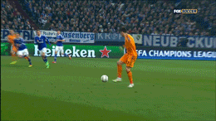
GOALS
Review introductory JS concepts:
Data Types
Arrays vs Objects
Looping (Array and Object)
Write Functions
HTML/CSS Interaction
Introductory jQuery
Intermediate JS Concepts (Time Permitting)
Notes:
Credit: https://giphy.com/gifs/foxsports-football-soccer-futbol-Qw4X3FCYb9sflH9HgBO

Slide 6

MAKE A FRIEND!!
Notes:
Stand up - Turn to the person on your right – or left – say your name, where you work, and your favorite type of cheese – or if you’re lactose intolerant, what kind of snack you enjoy – 2 min!
Credit: http://giphy.com/gifs/friends-rachel-green-tv-VZXuygf0oUb5u

Slide 7
Informative Conversation Statements
THERE ARE NO STUPID QUESTIONS!
ASK QUESTIONS OFTEN!
PLEASE CODE-ALONG WITH ME!
I ❤️ QUESTIONS!
Notes:
I may not always know the answer but we can explore together.
IN FACT – ASK ME A QUESTION RIGHT NOW! ANY QUESTION!

Slide 8
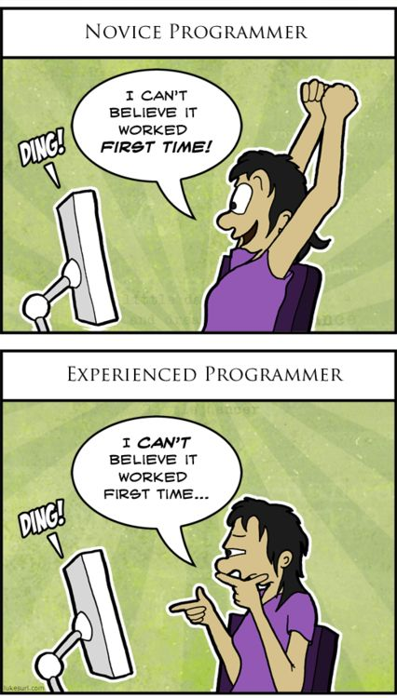
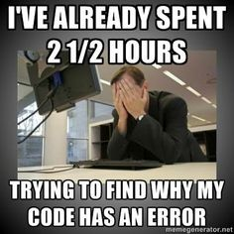
Our Agreement (Repeat After Me)
I am going to make mistakes.
I am going to get things wrong.
I am going to fail.
This is okay!
Notes:
1st picture is extastic
2nd picture is suspicious

Slide 9
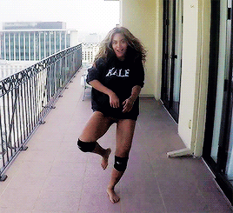
LETS GET TO IT!
Notes:
Credit: https://giphy.com/gifs/beyonce-moments-dial-I8XaJ6ZEFHI3u
As we go through this do not hesitate to stand up and walk around. Sitting for 3 hours isn’t fun – I won’t be doing it sooooo you shouldn’t have to either!

Slide 10

Getting Started
Download code from repo https://github.com/maabrown/JS_Class_Sept_2016
Find folder on your machine using ‘Finder’ (Mac) or ‘Windows Explorer’ (PC)
Open folder (directory) in Code editor – Sublime, Atom, or other of choosing
MAC
Drag icon of ’index.html’ file to your web browser icon
PC
Double-click index.html (or index)
Notes:
Everyone needs the repo for an exercise we are doing later in the lesson
Windows Explorer is the icon

Slide 11
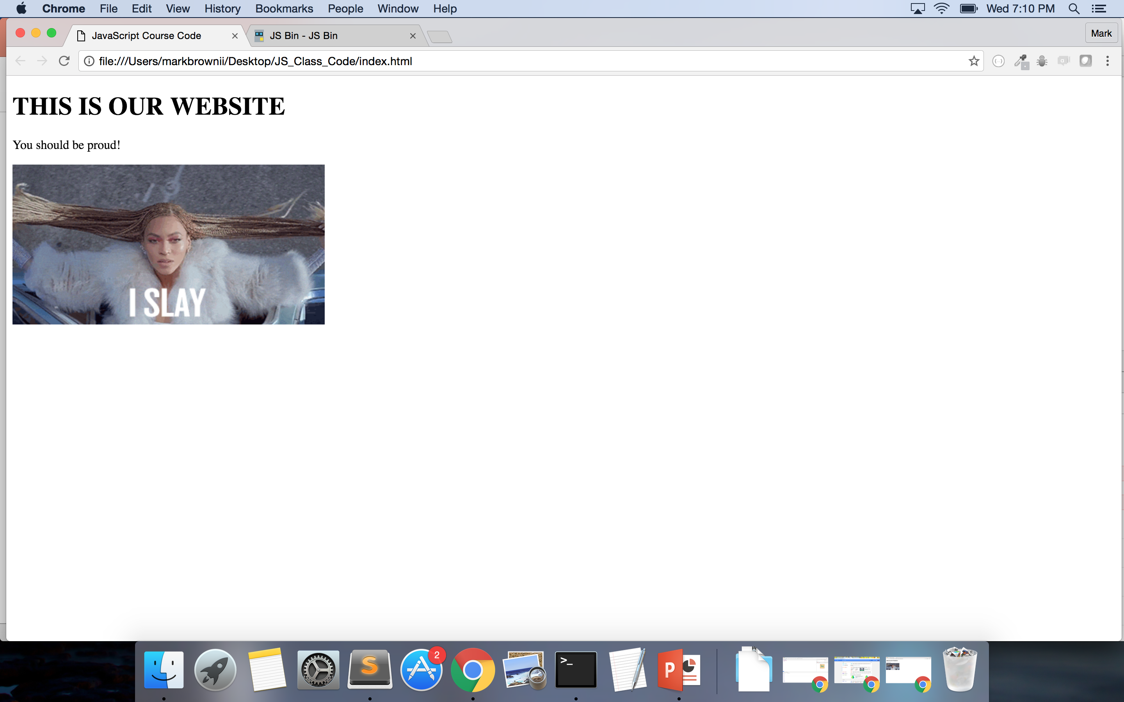

Slide 12
2 OPTIONS
Console on your web browser (Going over this option first)
OR
JSBin.com (This option second)

Slide 13
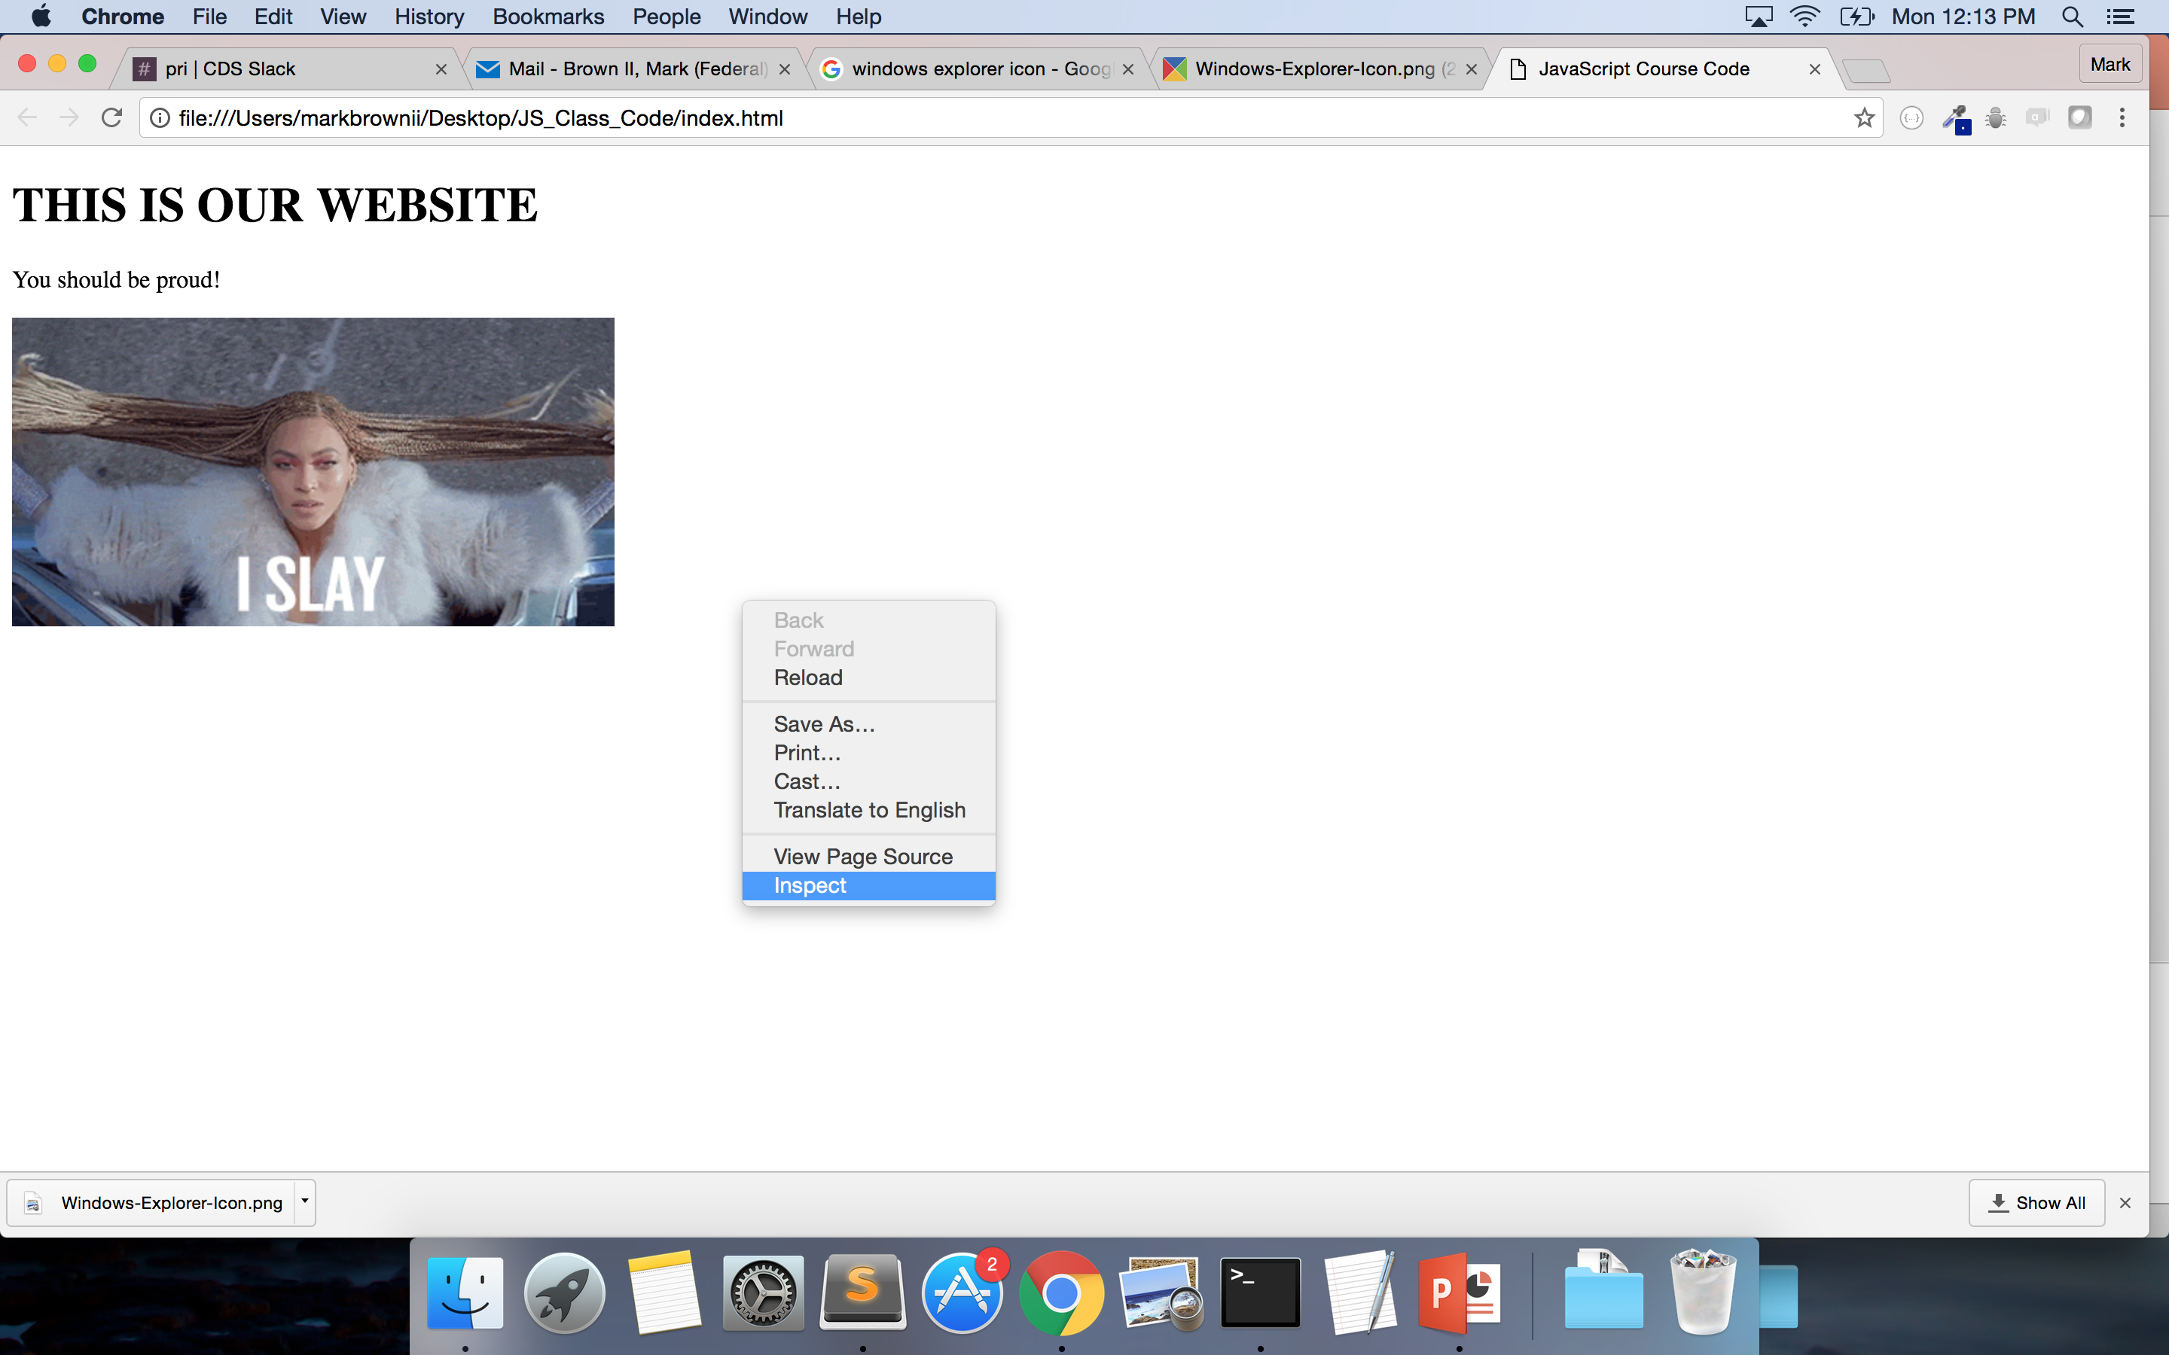
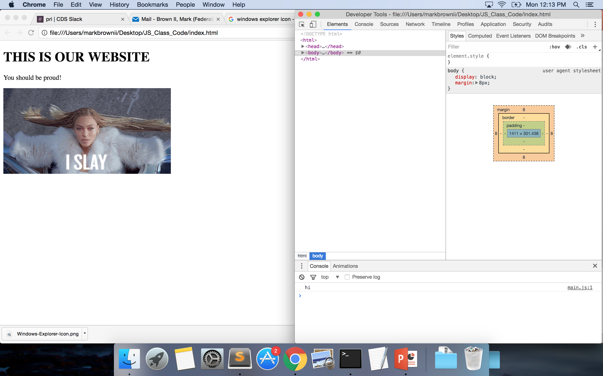
Developer Tools (on Chrome)
Right click page
Select Inspect
Notes:
Firefox – Inspector
Opera – Dragonfly
We won’t be working with the HTML and CSS today so feel free to make your console bigger.
PAUSE HERE IN CASE SOMEONE GETS LOST – Go through it quickly

Slide 14
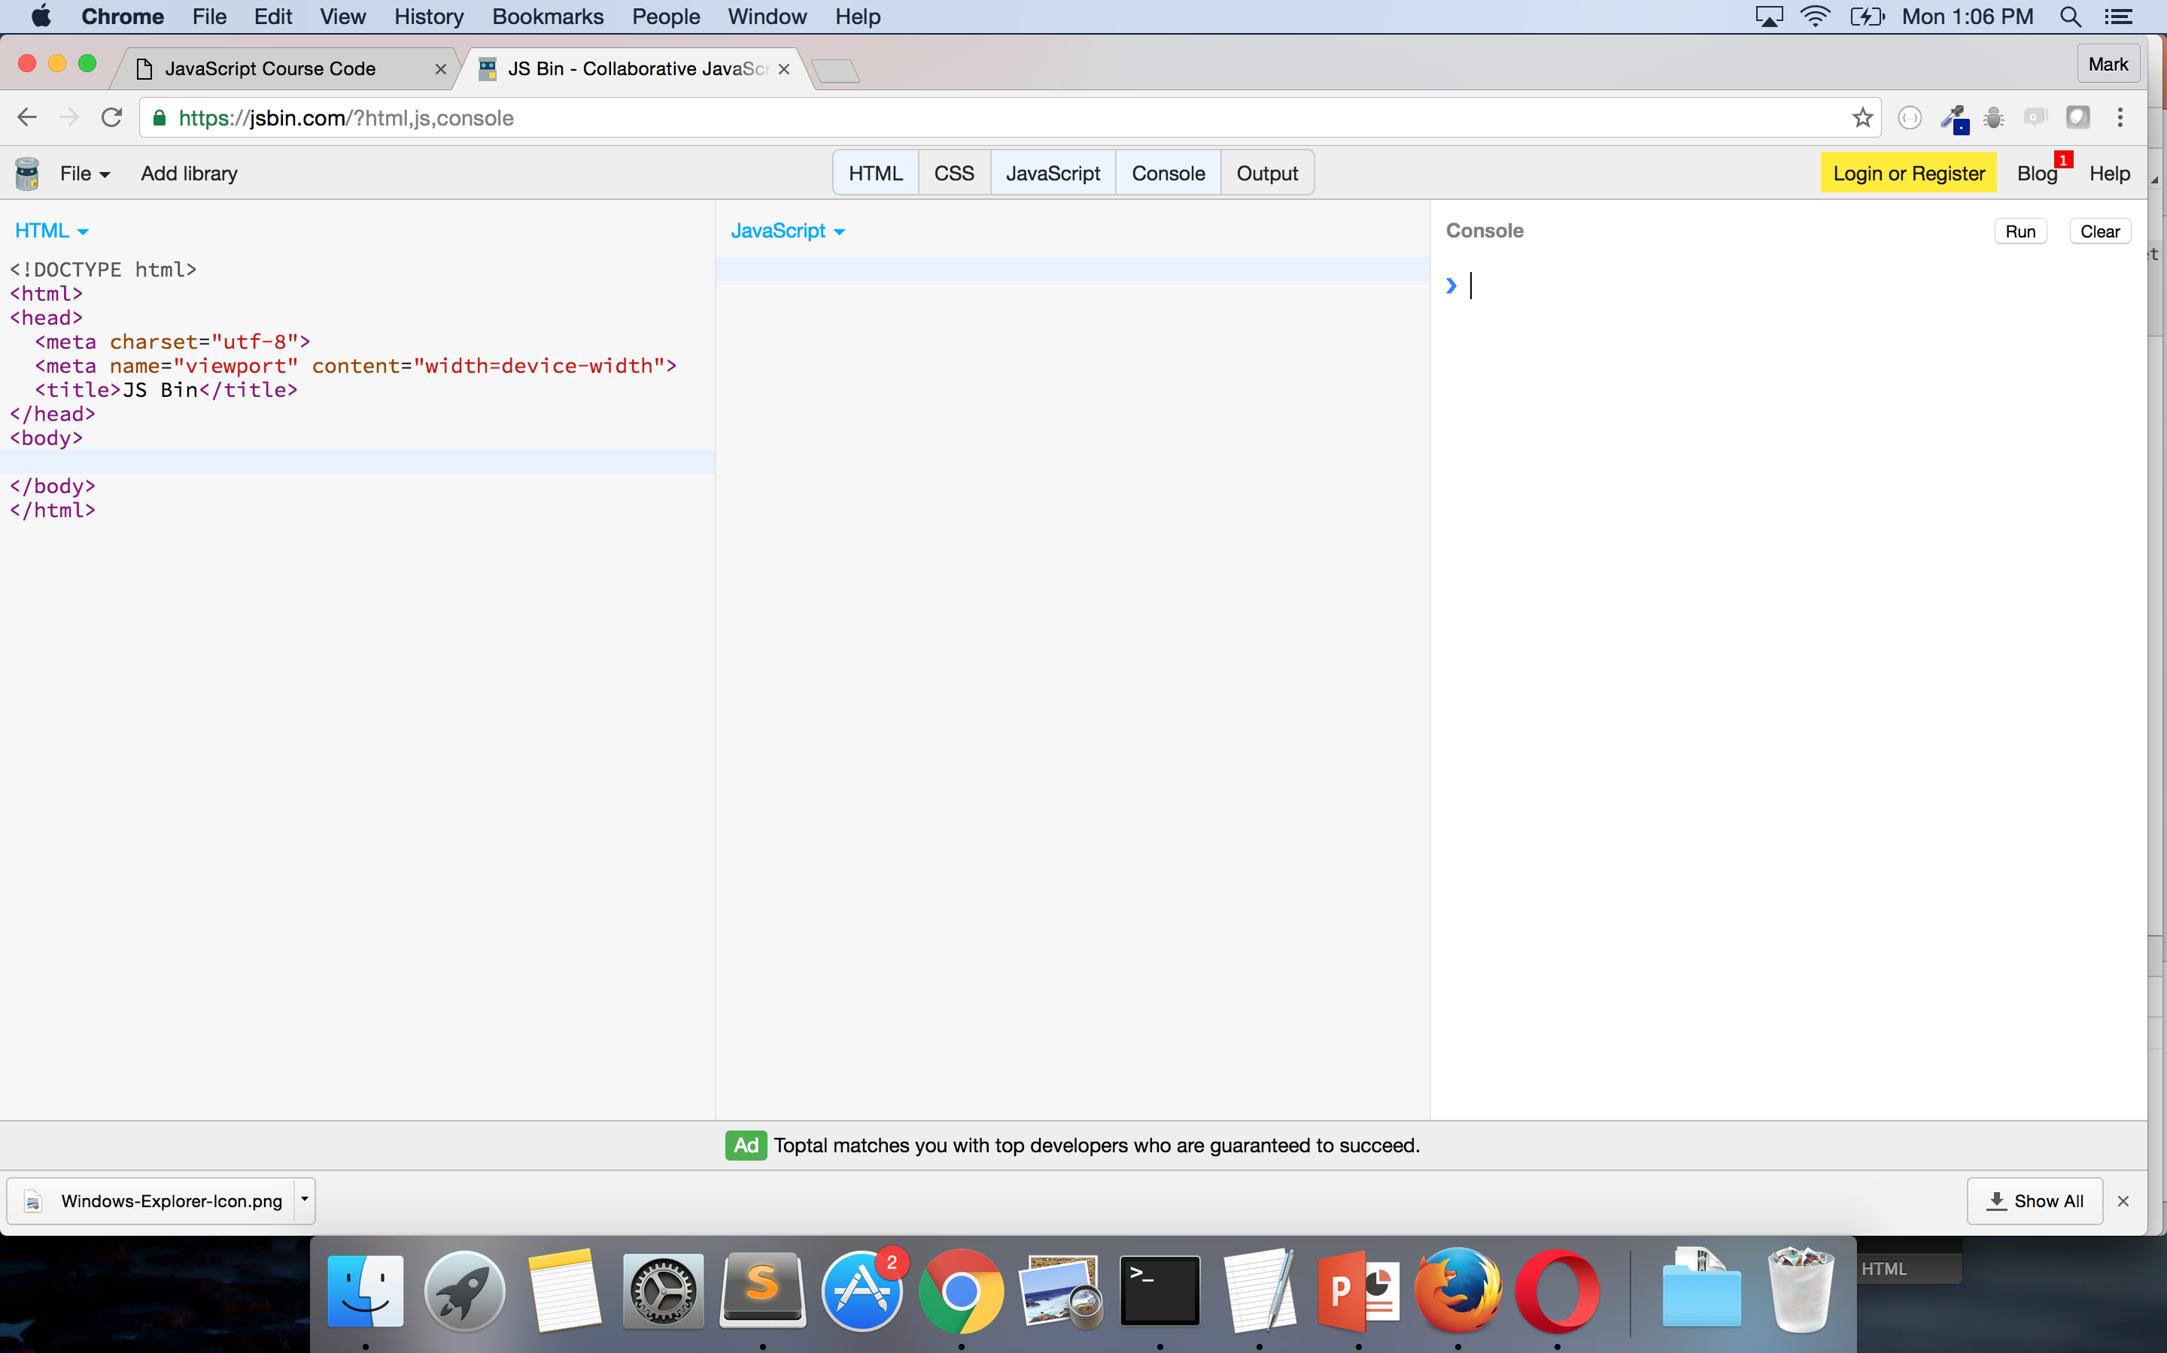
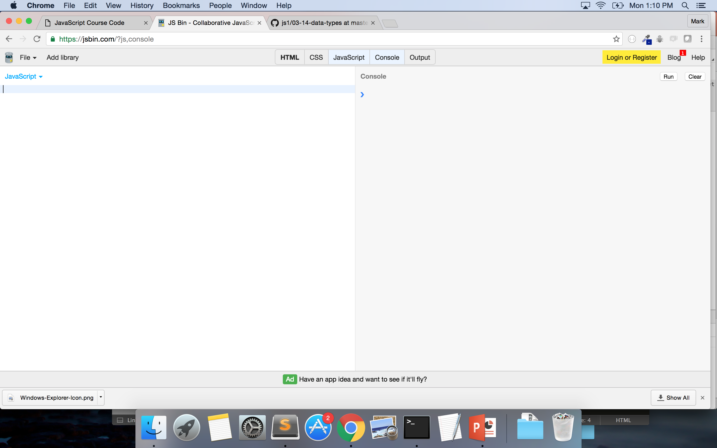
JSBin.com
Go to JSBin.com
Select ‘JavaScript’
Select ‘Console’
Unselect ‘Output’
Unselect ‘HTML’
Notes:
GO THROUGH THIS ON YOUR COMPUTER AS WELL!
Is everyone good??? THUMBS UP OR THUMBS DOWN!

Slide 15
Data Types
What is a data type?
It is a classification identifying one of various types of data
7 Types of Data:
String
Number (Integer and Float)
Boolean
Array
Object
Null
Undefined
Notes:
Credit: https://en.wikipedia.org/wiki/Data_type

Slide 16
STRINGS
Textual data
MUST Surrounded by double (sometimes single) quotes
Consists of characters
Spaces are characters
Zero-indexed (which includes spaces)
Examples:
”Hello”
“5”
“{ key: value }”
“kittens”
Notes:
Spaces are characters in strings – space between curly brace and k in key is a character
H’s index is 0
What is e in ‘kittens’? -- 4
What is the index of the ’o’ in hello? -- 4

Slide 17
NUMBERS - INTEGERS
Whole numbers – no decimals
Does not have a delimiter (a character that is used as a boundary in a data stream) – e.g. “,”
NaN is a number
Examples:
42
-3
10000000000000000
Notes:
Credit: https://en.wikipedia.org/wiki/Delimiter

Slide 18
NUMBERS - FLOATS
Numbers with decimals
No delimiter
Examples:
4.5
-1.333333333
5968332244.33324
3.141592
Notes:
Can anyone tell me what 3.141592that is?

Slide 19
BOOLEAN – NULL - UNDEFINED
Boolean
Values of ‘true’ or ‘false’
Undefined
Variable without a value
Null
Essentially something that doesn’t exist
Notes:
Credit: http://www.w3schools.com/js/js_datatypes.asp
We will discuss

Slide 20
ARRAY
Ordered collection of data
Zero-indexed
Can have mixed data types
Technically is an ‘object’ data type
Delimiters used:
[] – to open and close an array
, - to separate items within an array
To get the value in an array:
arrayName[index]
Examples:
[3, 2, “hello”, {}, 4.555555, true] ← One array
[“hello”], [37, 91] ← Two arrays
[ [3,2,”hello”], 45, “laugh”] ← One array but an array within an array
Notes:
As in math - the brackets work like parenthesis

Slide 21
OBJECT
Unordered collection of data
Can have mixed data types
Key-value pairs
KEY: VALUE
Delimiters used:
{} – used to open and close objects
: - used to separate key from value
, - used to separate different objects and key-value pairs in objects
Access values 2 ways:
objectName[key] = value
newObject[name] = ”Mark Brown II”
newObject[“position”] = ?
objectName.key = value
newObject.employer = ?
Examples:
{name: ”Beyonce”, num_of_awards: 195}
{albums: [‘Bday’, ’Dangerously in Love’, ‘Lemonade’]}

Slide 22
OPERATORS
Know most from math
-
Subtracts numbers
/
Divides numbers
*
Multiplies numbers
+
Add numbers, concatenates Strings
%
Returns the remainder from the division
Notes:
Does anyone know what the modulus does?
SPEAKING: "he" + "llo" = "hello"
Go to jsbin or console and show examples
Make sure to do string subtraction – console.log(“hi” – “i”) → NaN
Returns NaN because of JS coercion!
When JS sees that math is being done, tries to convert the strings to numbers – which they aren’t – and thus gives NaN
Another example: console.log(5 + “3”) returns “53” – JS converts 5 to a string and then concatenates since 3 was a string
We see 3 as a number with quotes but the computer just sees it as a string regardless of it being a number in between the strings and since you can’t do math on strings it makes 5 a string – You and the computer are different

Slide 23
Console.log - typeof
Console.log()
Is a function
Returns the value given to the function
Put the computation you want in between the parentheses -- console.log(“hello”);
typeof
Is an operator
Tells you the data type of an input
Type ‘typeof’ – give it a space – put the value you want to evaluate -- typeof {}
Notes:
Built-in: Functions (which we will discuss later) that are native to JavaScript
Native means that you don’t have to write any code to use them
MUST USE CONSOLE.LOG ON JSBIN!!!

Slide 24
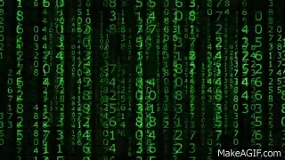
CODE-ALONG!
Notes:
DO CODE IN JSBIN – NOT THE CONSOLE!
ALWAYS END STATEMENT WITH SEMICOLON!
MUST USE CONSOLE.LOG ON JSBIN
Console.log(“Mark”);
Console.log(65);
Console.log([4,7,10]);
Console.log(Mark); → so they see that it gets ‘undefined’
Console.log(typeof ‘Mark’);
Console.log(typeof 65);
Console.log(typeof [3,4]);
Console.log(3+5);
Credit: https://giphy.com/gifs/gh-C6UVM5TbW1Y2s

Slide 25
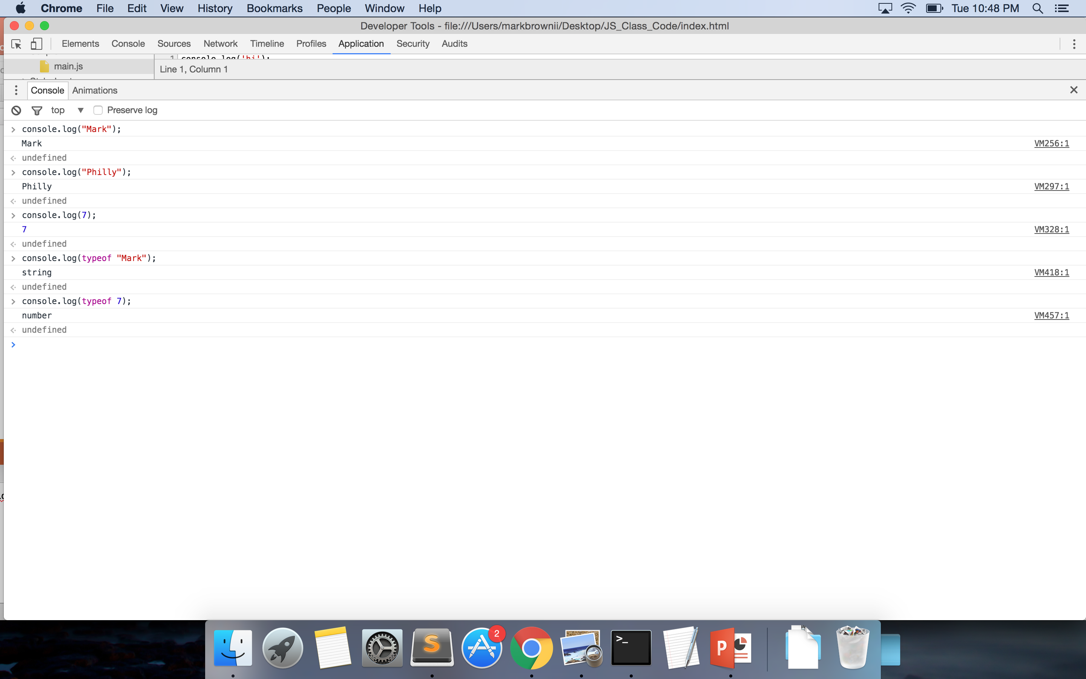
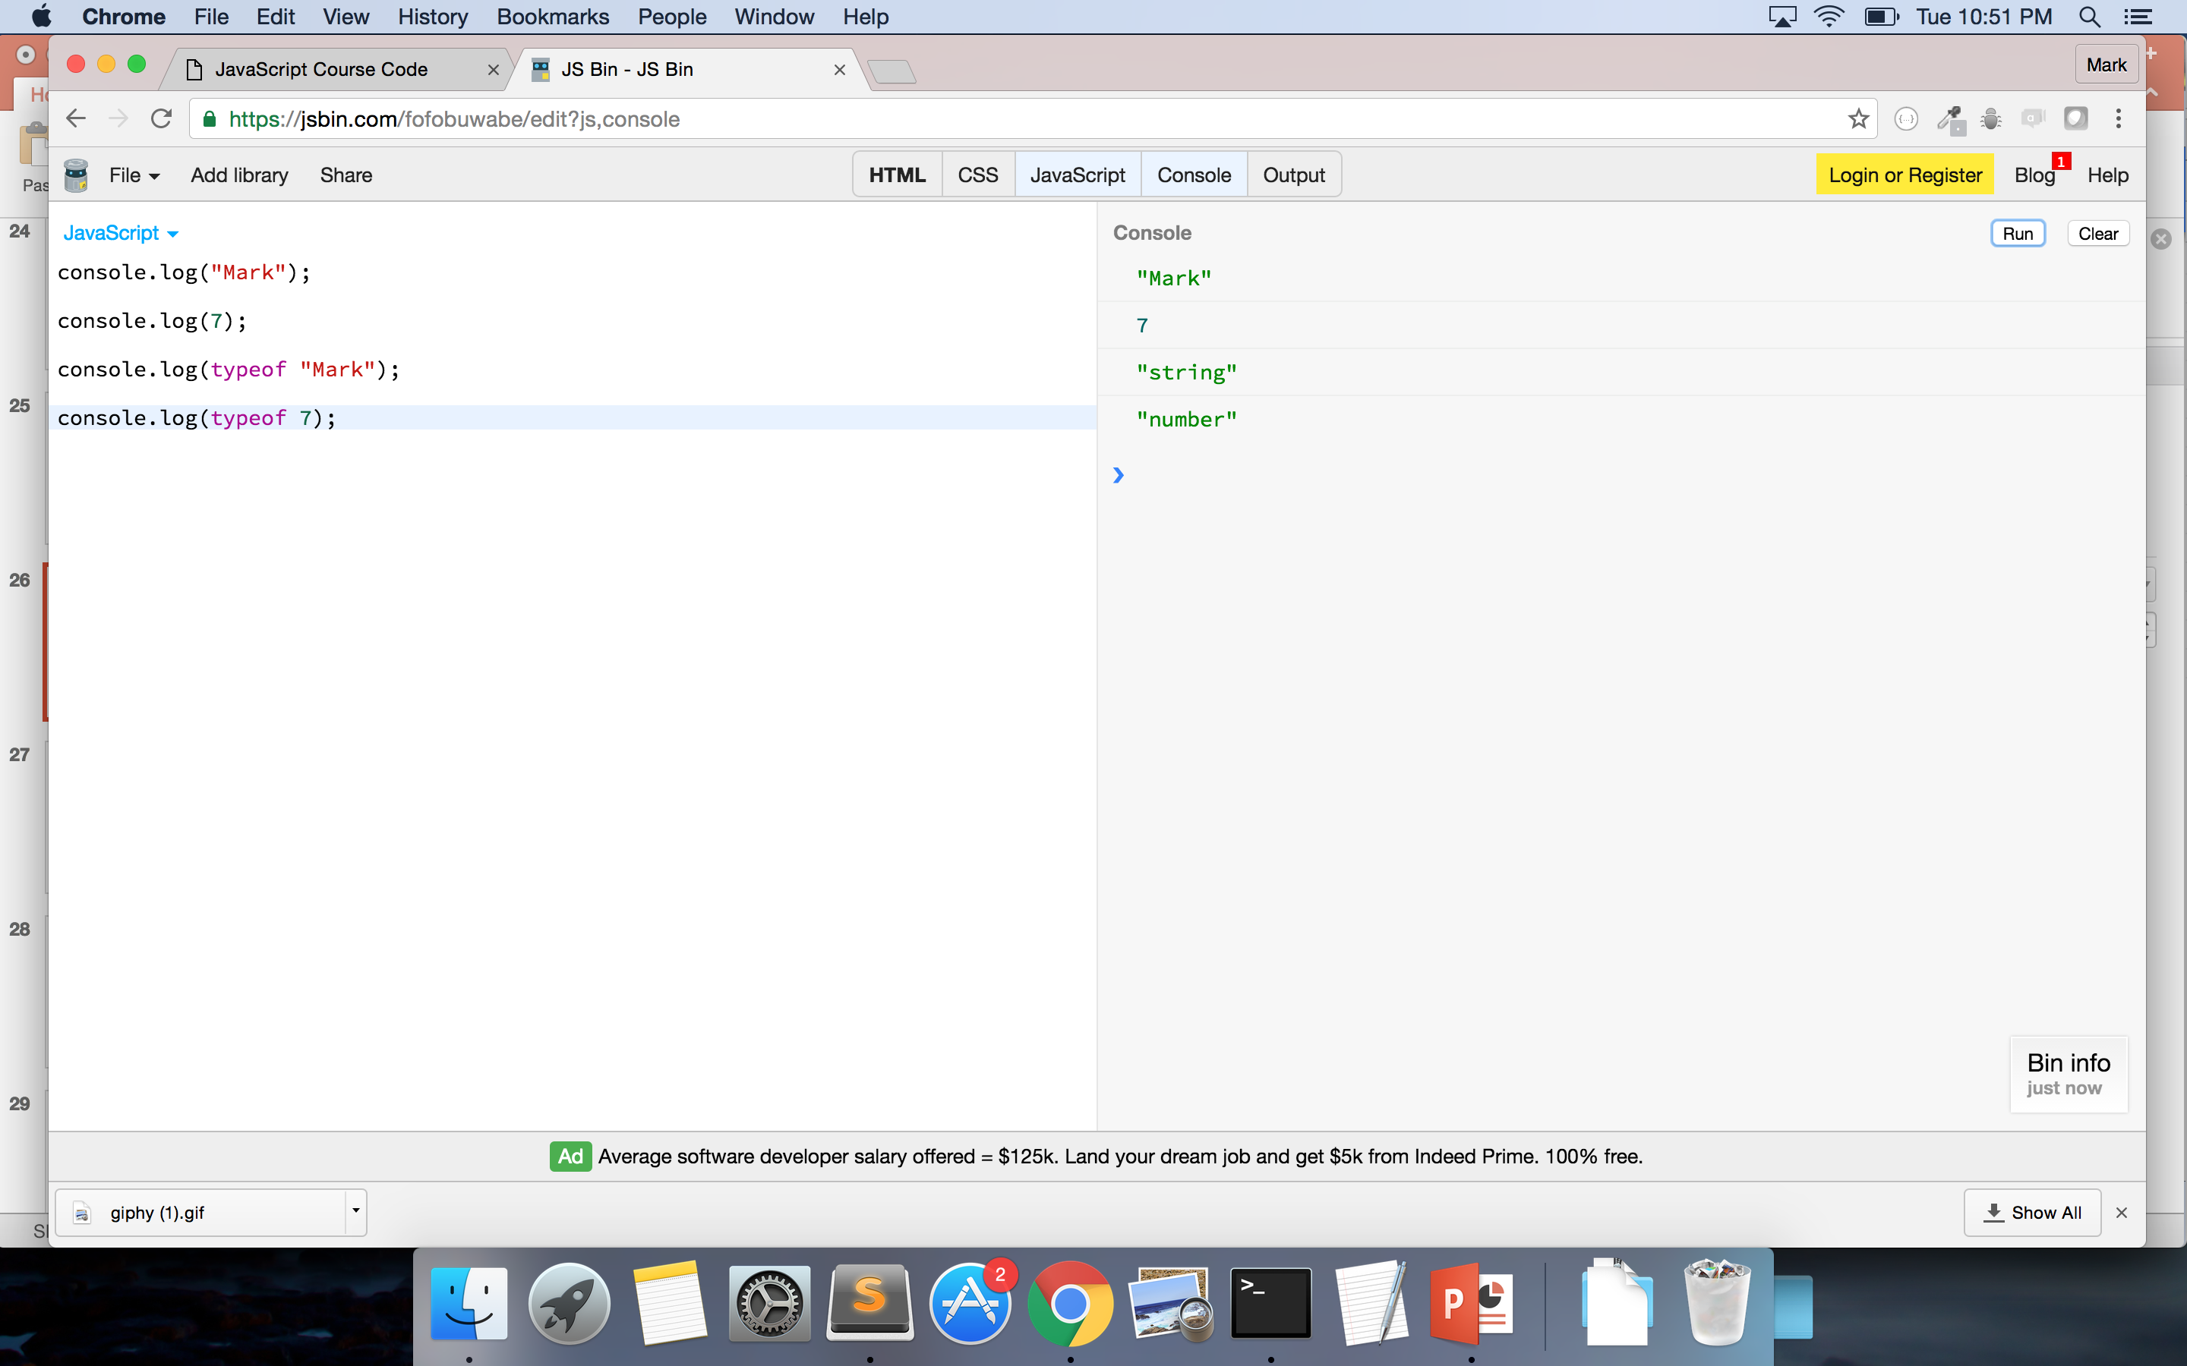
REDO THESE IMAGES

Slide 26

POP QUIZ!!
1. What are the differences between Integers and Floats?
2. Is “5” the same as 5?
3. ‘True’ and ‘False’ are what type of data?
4. What are the differences between an array and an object?
5. True/False: I can have mixed data types in my array.
6. How can I check a datatype using my computer?
Notes:
Credit: https://giphy.com/gifs/m4QebXYgrWGkw

Slide 27
VARIABLES
Used to store information to computer’s memory for future use
Declaring
Always use keyword ‘var’
var myName
Assigning
Can assign variables any value – including arrays, objects, functions
var myName = “Mark”;
Always use a “;”
Calling
How you access the variable’s value
Use variable name – not the value
Returns ‘undefined’ if variable isn’t assigned a value
Notes:
Mention camelCase or _underscore – consistency is key
Check with framework – sometimes _underscore can have implications in your code
Go to Console and do:
var a
Var a = 5;
A
If using JSBin – you must must declare and assign variable outside of console.log() – you can console.log to call the variable
If you don’t declare and assign – console.log will tell you it is not defined

Slide 28
ARRAYS (cont.)
Store data
Consists of ‘elements’
Zero-indexed (index starts at 0)
Data can be added, deleted, and changed
Some methods:
Reverse()
toString()
length (property – not a method)
var names = [‘Beyonce’, ‘Bey’, ‘Yonce’];
names[0] = ‘Beyonce’
names[2] = ?
var sailorNames = [‘Moon’, ‘Jupiter’, ‘Mars’, ’Venus’, ‘Mercury’];
sailorNames[2] = ?
sailorNames[0] = ?
sailorNames[3][0] = ?
sailorNames[1][6] = ?
Notes:
is there a variable on this slide? yes - how do you know?
what is the name of the first variable on this slide?
is the variable declared? why?
is it assigned? why?
the value is what data type? and how do you know it is that data type?
what is the first element in the first array? Second element? third?
how do you know it is the first element?
Due to index – do you understand why order is important?
Use JSBin to do:
var dsNames = [”Kelly”, “Michelle”, “Beyonce”]
Console.log(dsNames.length)
var memberName = dsNames[1]
memberName
Can use the keyword ‘new’ so var newArray = new Array(‘things’, ’to’, ’do’); - but not seen as best practice

Slide 29
OBJECTS (cont.)
Store data
Consists of ‘key-value’ pairs
Data can be added, deleted, and changed
Order does not matter - indexed by the ‘key’
Access values 2 ways:
objectName[key] = value
newObject[name] = ”Mark Brown II”
newObject[“position”] = ?
objectName.key = value
newObject.employer = ?
var newObject = {
name: ”Mark Brown II”,
position: “ Developer”,
employer: “Department of Commerce”
}
Use “ “ when key has number or other special characters
Use same notation to add key/value to object
newObject.hair = “natural”
Notes:
Keys can be numbers but you can’t use them without using double quotes “ “ and you can’t use . (dot) notation

Slide 30
EVEN MORE PRACTICE
var practiceArray = [
“JavaScript”,
“Ruby on Rails”,
“C++”,
“AngularJS”
]
What is practiceArray[2]?
How would I get the value of ‘AngularJS?
How would I get the length of practiceArray?
var practiceObject = {
develop: “web”,
language: “JavaScript”,
dataType: “object”,
bureaus: [
“BEA”, “NOAA”, “NIST”, ”MBDA”
]
}
What are the keys in this object?
What is the value of practiceObject[“language”]?
How would I get the value ‘NIST’?
Notes:
Please make sure to use the DOUBLE QUOTATION MARKS FOR JSBIN

Slide 31
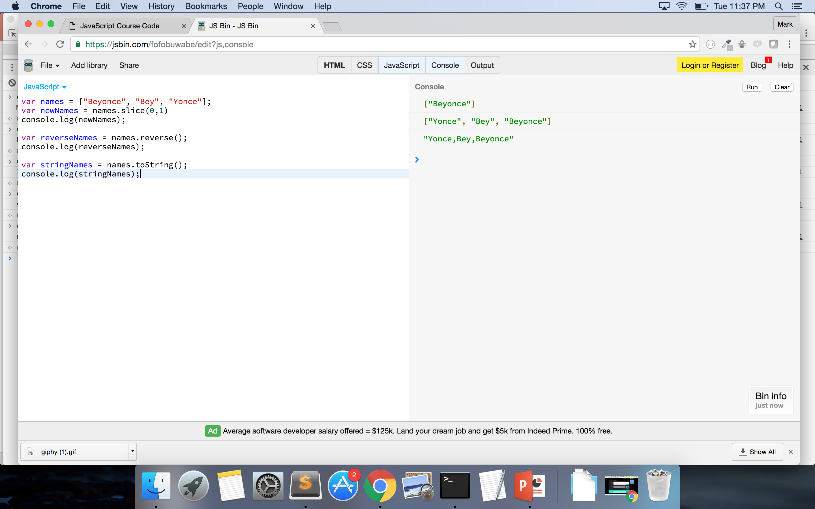
REDO THESE IMAGES

Slide 32
REPEAT AFTER ME!
ALL ARRAYS ARE OBJECTS
ALL OBJECTS ARE NOT ARRAYS
Notes:
Only way to check for type with an array is to use Array.isArray() -- https://developer.mozilla.org/en-US/docs/Web/JavaScript/Reference/Global_Objects/Array/isArray
Array.isArray([3,4,]) ➔ ‘true’
http://stackoverflow.com/questions/5048371/are-javascript-arrays-primitives-strings-objects
Really arrays are objects – but rather than having { 0: value, 1: value}

Slide 33

QUESTIONS????
Notes:
Credit: https://giphy.com/gifs/yosub-beyonce-question-queen-bey-3o85xlbbhWbrwLvFO8

Slide 34

BREAK! – 5 MIN
MOVE THIS TO THE PROPER PLACE

Slide 35
JSON
JavaScript Object Notation
Data objects consisting of attribute-value pairs
Passed back from AJAX calls – calls to API (Application Program Interface)
Based on JS – can be read by many other languages

Slide 36
PSEUDOCODE!!!!
Text-based detail breakdown of what you want to do in your code
MAKE NO ASSUMPTIONS
Every detail counts!!
1. I want to alphabetize everyone’s first name in this room.
2. I gave you a list of 10 numbers, how would I put them in order?
Notes:
USE SUBLIME!!

Slide 37
PSEUDOCODE (Your turn – Pair Programming)
How would you code the following:
1. I give you a list of words. I want you to capitalize the first letter of each word.
2. I hand you a grade book with 10 grades in it. If a grade is greater than 60, print “passed” – else, print “failed”
3. I give you a box full of books and tapes, I want you put the tapes in one box and the books in another. Give be back both boxes.

Slide 38
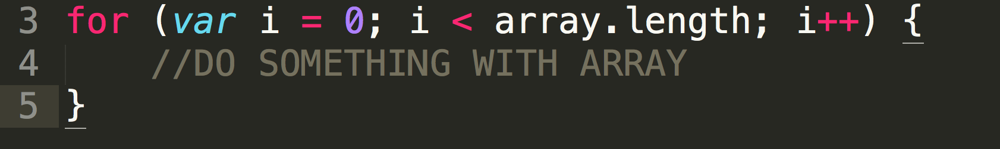
LOOPING (aka ‘For Loops’) - ARRAY
Incrementors:
++ increments by 1
-- decreases by 1
”i” is just a counter
Notes:
Boxes of videos are objects or arrays
The list of names are arrays or objeccts

Slide 39
CODE-ALONG!
Notes:
Credit: https://giphy.com/gifs/gh-C6UVM5TbW1Y2s

Slide 40
PRACTICE – 5 Min.
MAKE A NEW EXAMPLE
Go to repo
Open main.js
1. Write a ‘for’ loop that logs every item in the beyonceSongs array.
2. Write a ‘for’ loop that logs every item in the beyonceMovies array.
Notes:
I do the first
Someone tells me how to do the second

Slide 41

SHOW/TELL ME YOUR CODE!!!
Notes:
Use Sublime
Credit: https://giphy.com/gifs/cheer-cheering-11sBLVxNs7v6WA

Slide 42
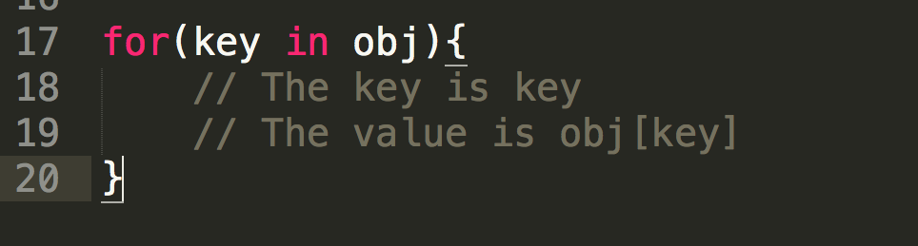
LOOPING (aka ‘For-In’) - OBJECT
Notes:
REMEMBER:

Slide 43
PRACTICE
MAKE A NEW EXAMPLE
Go to repo
Open main.js
1. Write a ‘for’ loop that logs every key in lemonadeAlbum.
2. Write a ‘for’ loop that logs every value in lemonadeAlbum.

Slide 44
CODE-ALONG!
Notes:
Credit: https://giphy.com/gifs/gh-C6UVM5TbW1Y2s

Slide 45

Notes:
Credit: https://giphy.com/gifs/bfv-braxtons-towanda-traci-3o7TKJbg9tcu3OkF7a

Slide 46

FUNCTIONS
Reusable statement or group of statements
Can be called anywhere within the program
DRY – Don’t repeat yourself
Use keyword ‘function’
Must be defined first → Called (usually) – when writing code
Technically – functions are objects
Related to concept of ‘first-class objects’
Notes:
DRY - never write the same code twice
Credit: https://giphy.com/gifs/excited-family-guy-stewie-griffin-7eAvzJ0SBBzHy

Slide 47
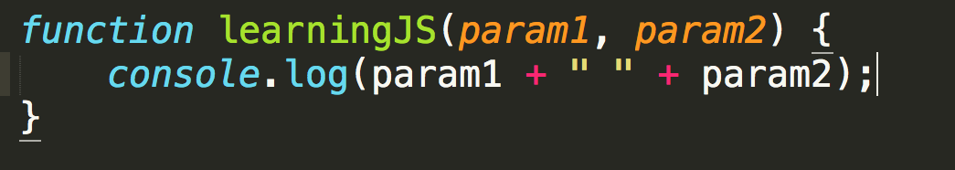
FUNCTIONS
4 Parts:
1. Keyword ‘function’
2. Name of the function (Optional)
3. Parameters (Optional)
4. Code inside the function (Optional)
Notes:
Context – I put optional by the name of the function because as you progress in JS you will find yourself potentially using anonomyous functions
And technically the code inside the function is optional because the computer will still run your function even if you tell it to do nothing but
Typically you want to name your functions and you want there to be code inside

Slide 48
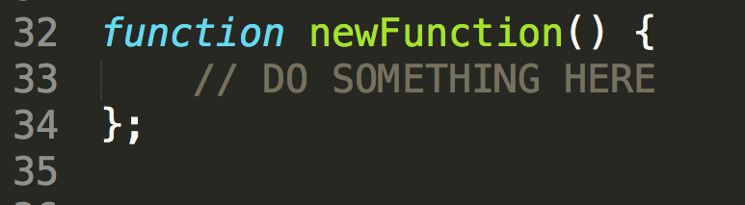
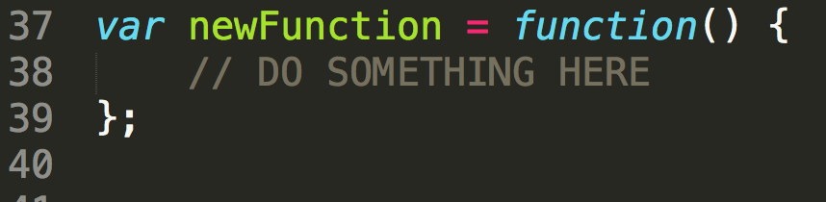
FUNCTIONS
DECLARATION
Expression
Names the function within the definition
Declares variable to name the function
Notes:
Expression has an Equals – double E as a mneumonic

Slide 49
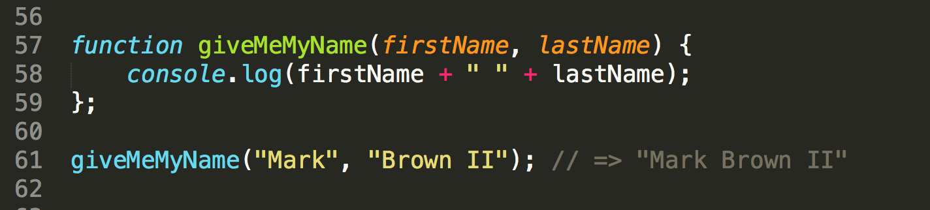
FUNCTIONS – Calling and Parameters
Write parameters in initial function definition
Pass in those values to function when calling it
Functions are called by () directly after their defined name
Uses those values in its computation
Notes:
Similar to variables – you define functions (declare variables) – and then you call them
Can have any number of parameters in a function
Parameters are in the definition
Arguments are the values you pass in

Slide 50
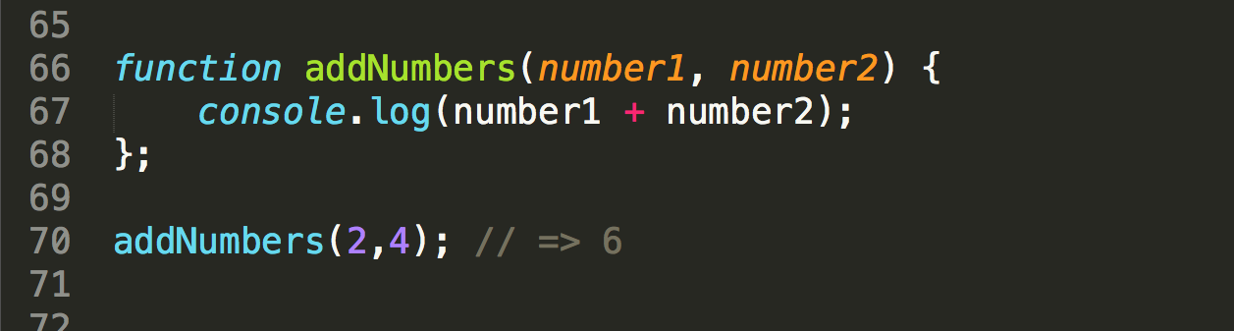
FUNCTIONS – Calling and Parameters
Notes:
Go to JSBIN
Do function subtractNumbers(num1, num2) {
console.log(num1 – num2)
}
subtractNumbers(7,3);

Slide 51
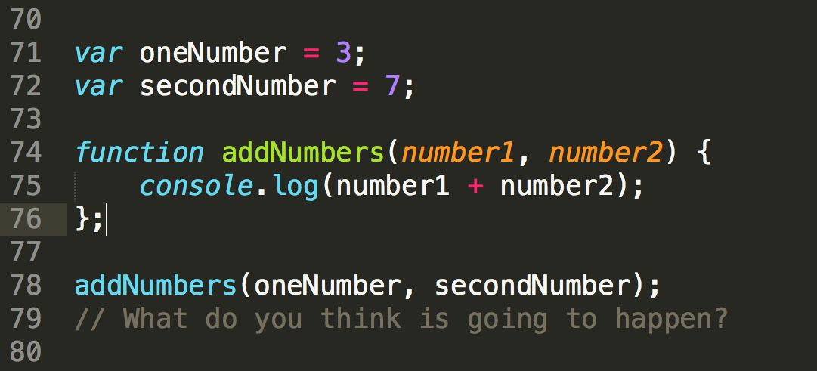
FUNCTIONS – Calling and Parameters
Notes:
Who wants to give me another way of writing this function WITHOUT using parameters?

Slide 52
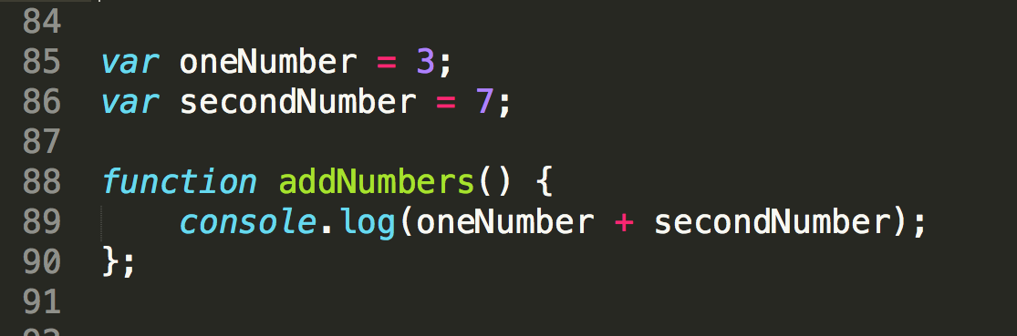
FUNCTIONS – Calling and Parameters
Notes:
Why parameters work? Because they allow you to re-use code. If you didn’t use parameters you would have to copy and paste this code somewhere else with other variable names – which is NOT DRY (do not repeat yourself).

Slide 53
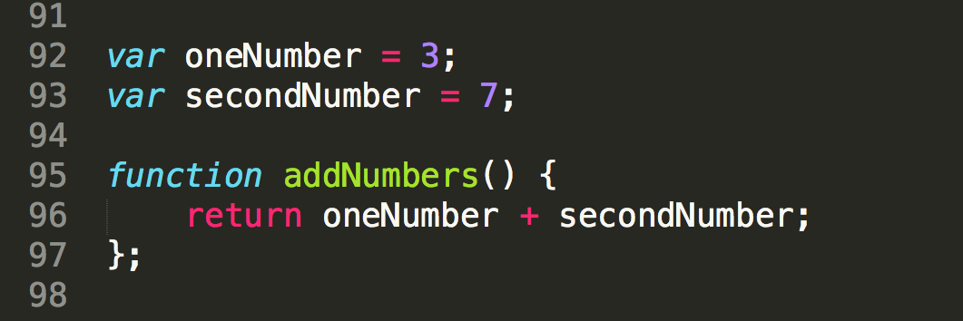
FUNCTIONS – keyword ‘return’
Returns the value of your function’s computation to the function’s moment of execution
‘return’ stops the function’s execution
Notes:
Not the same as console.log – console.log prints the information to the console
Return passes the value back to the point of execution for future use – usually this value is stored to a variable or is used in another function

Slide 54
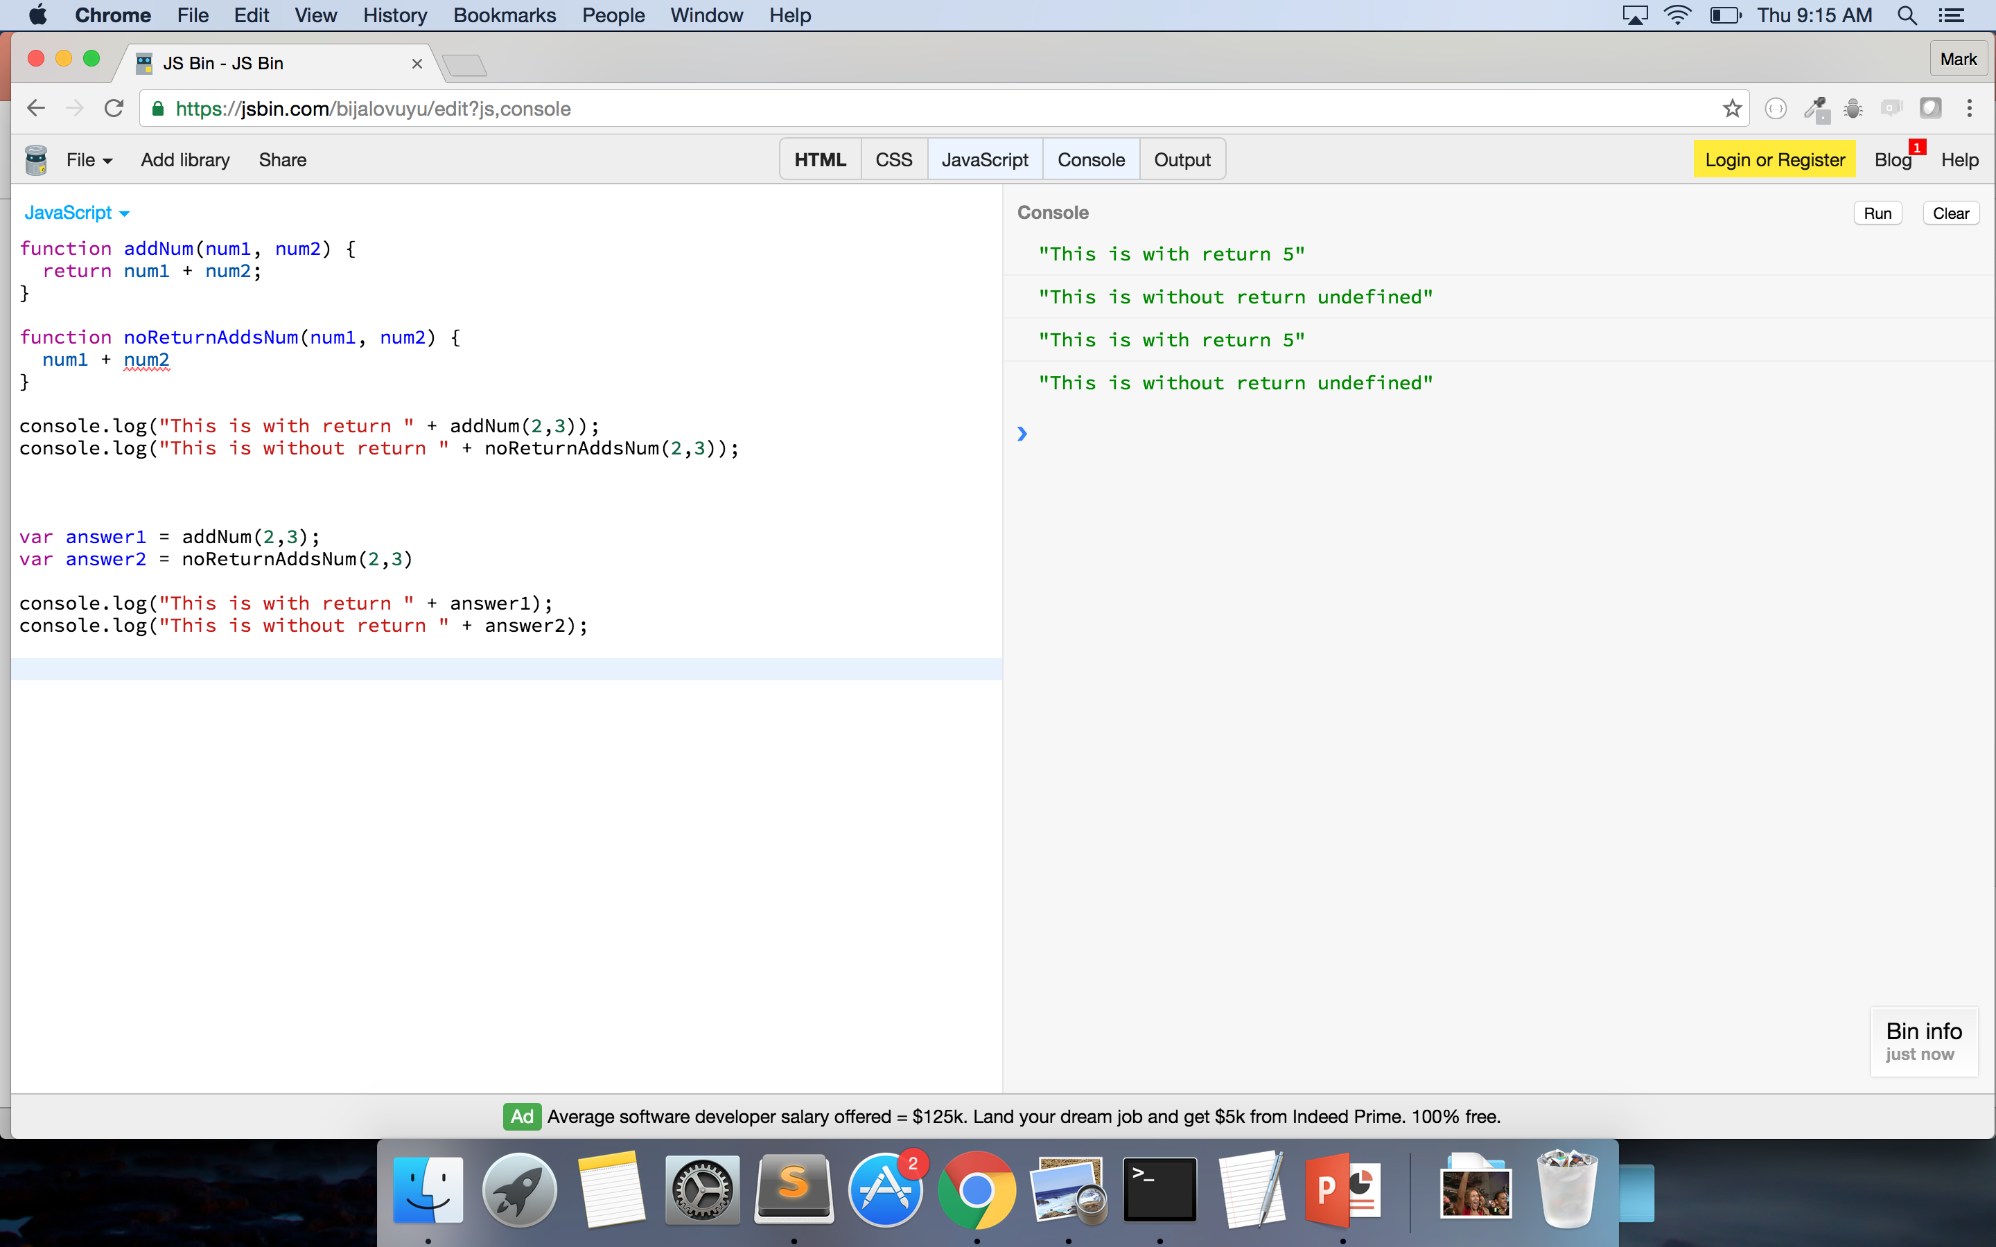
Notes:
DON’T TALK ABOUT CONSOLE VS RETURN
With first function return passes the value back
In the second – the function is performed but nothing is passed back – or returned – so the console prints undefined

Slide 55
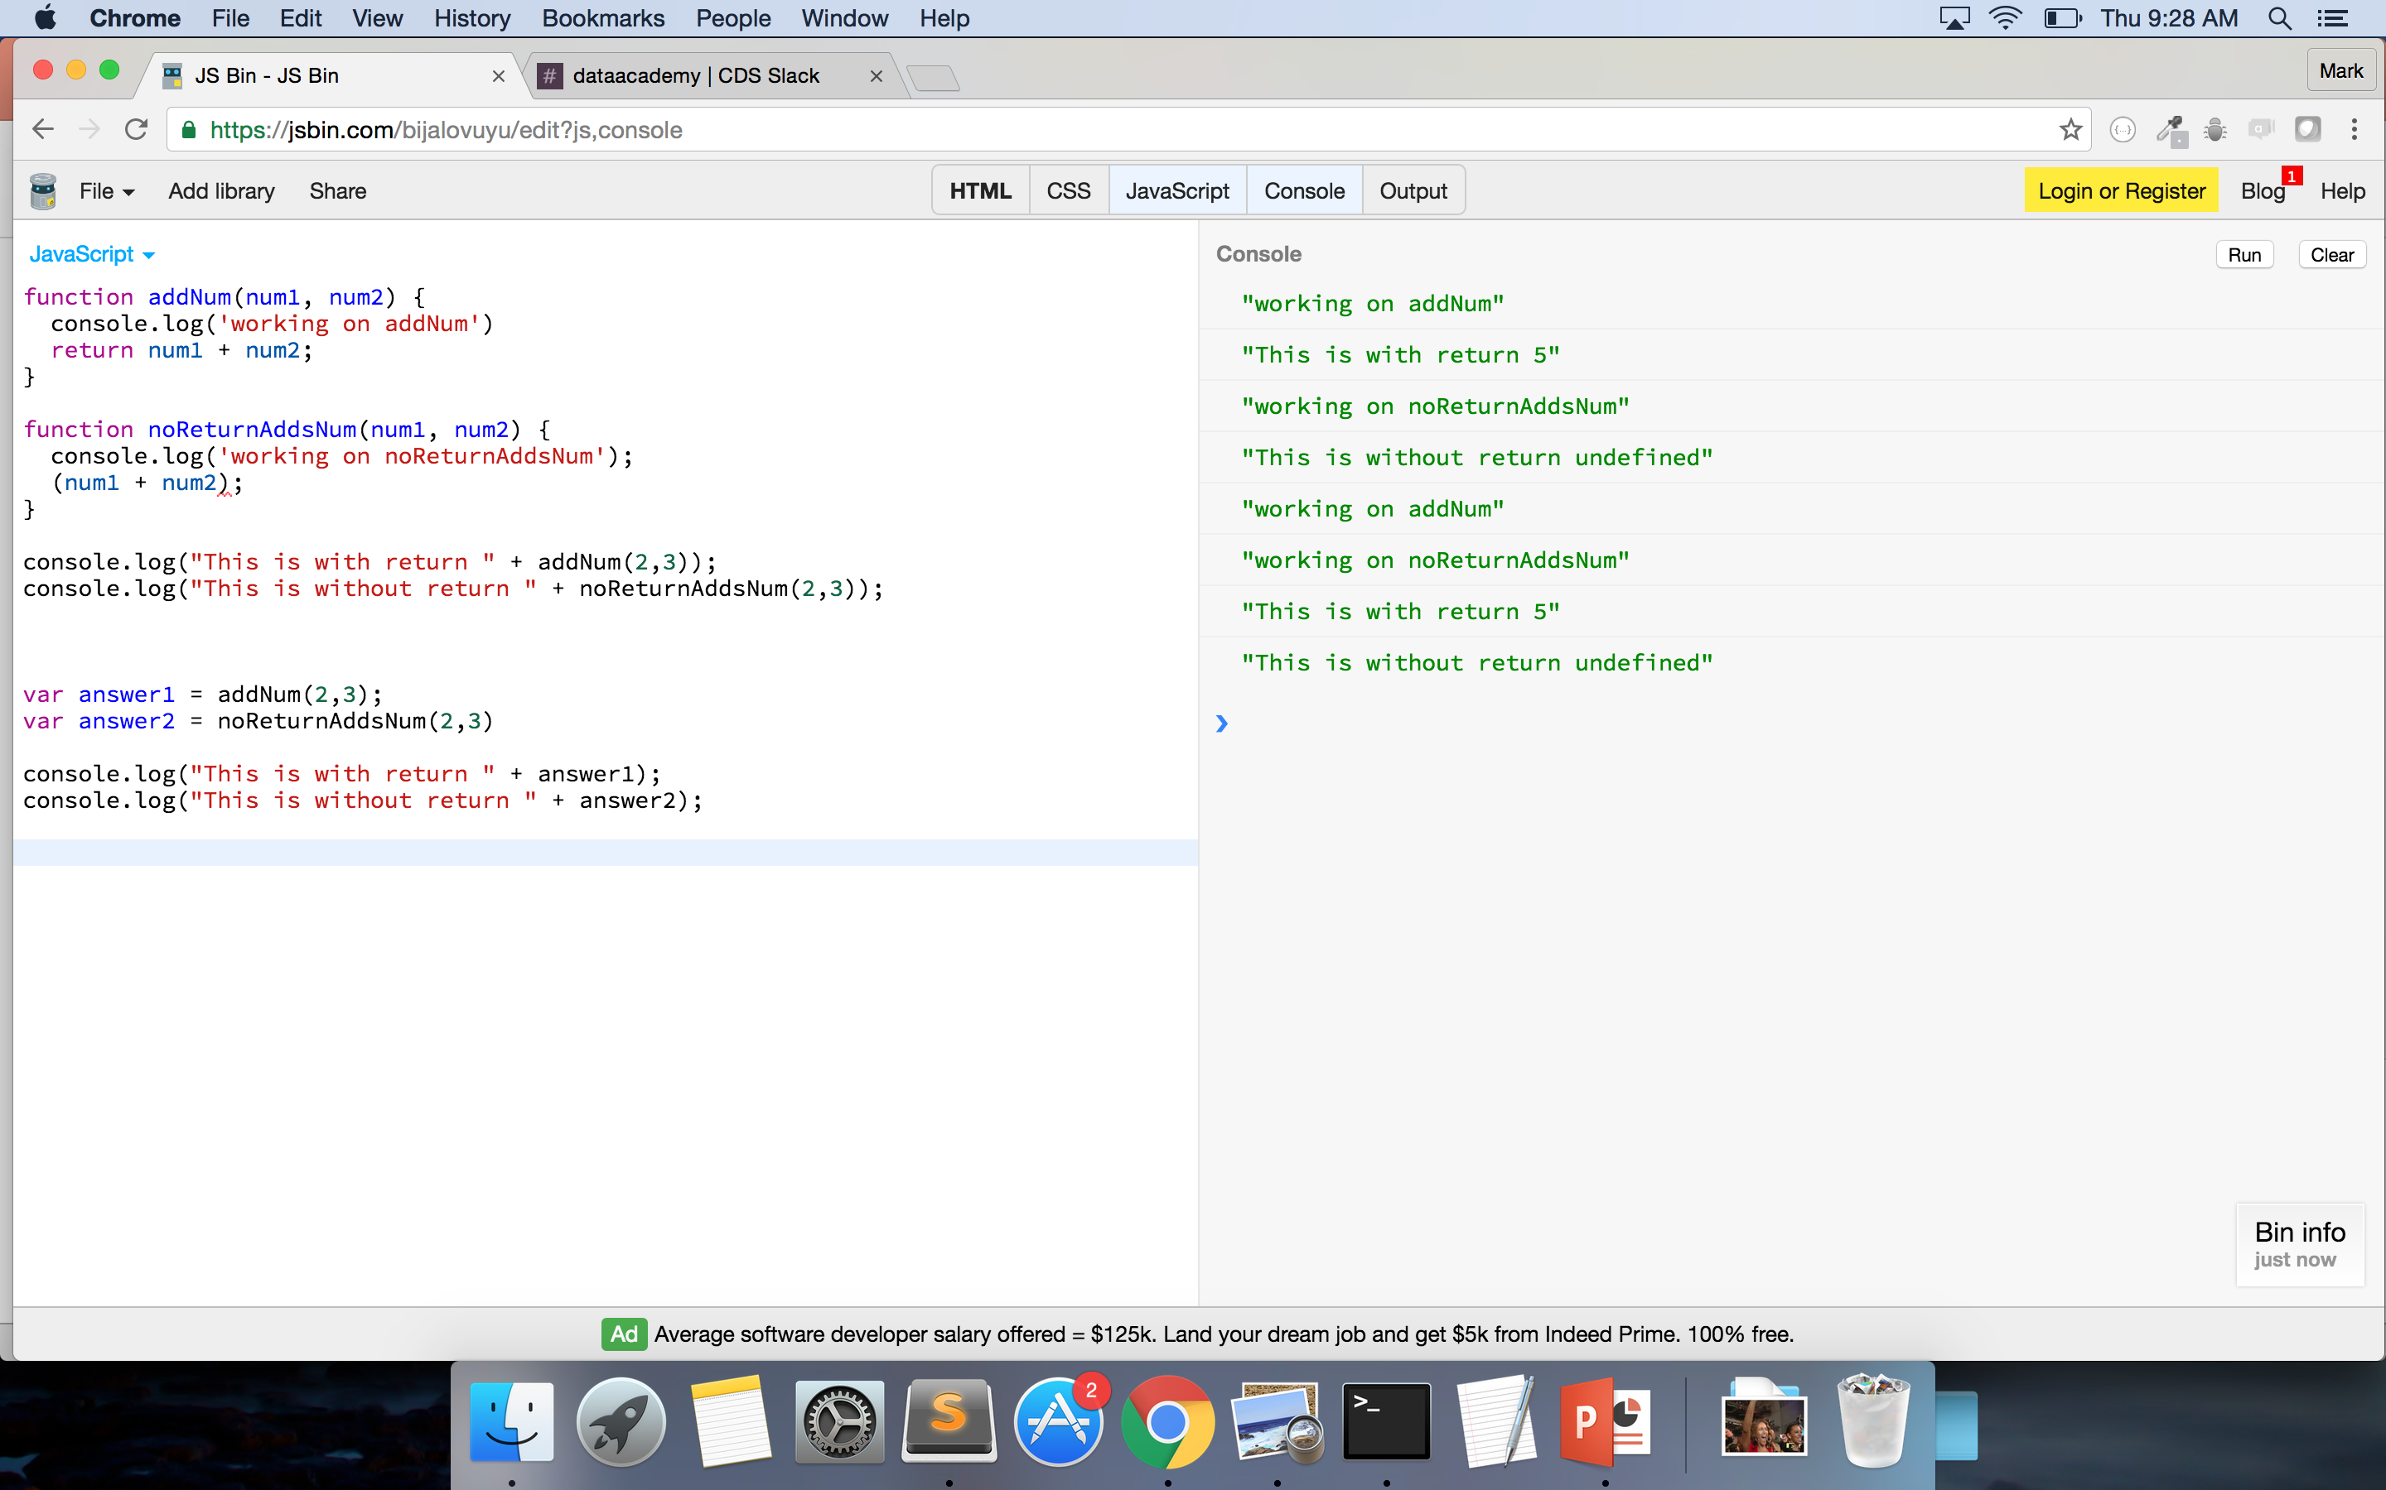
Notes:
Just to make sure the functions are working I’ve added in a console.log statement

Slide 56
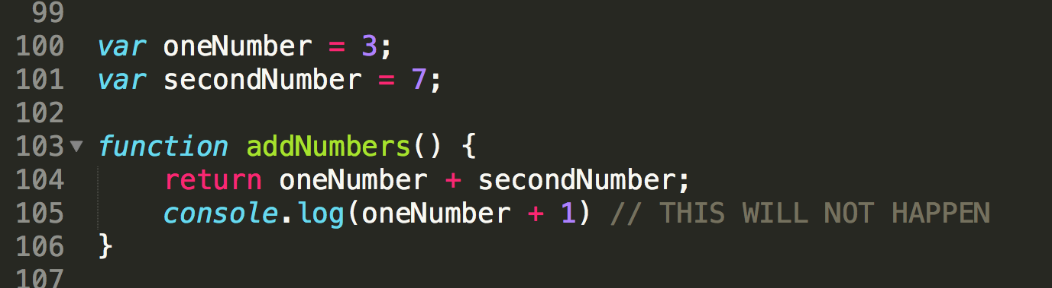
FUNCTIONS – keyword ‘return’
Notes:
With the keyword ’return’ the function stops as soon as it hits it – WHY?

Slide 57
JAVASCRIPT IS NATIVELY
SYNCHRONOUS!!

Slide 58
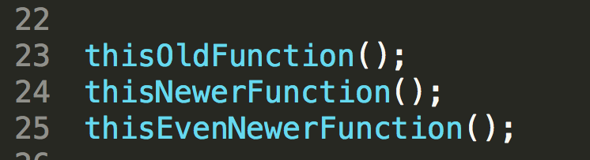
FUNCTIONS - Synchronous
Notes:
JS is Synchronous: http://stackoverflow.com/questions/2035645/when-is-javascript-synchronous

Slide 59
FUNCTIONS – keyword ‘return’
Notes:
With the keyword ’return’ the function stops as soon as it hits it – WHY?

Slide 60
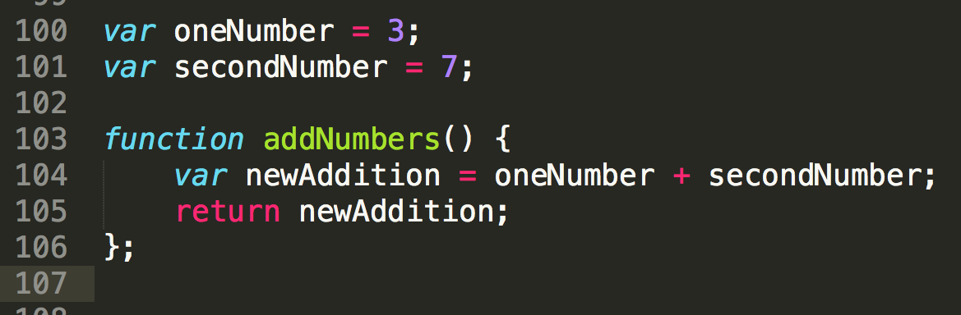
FUNCTIONS – keyword ‘return’
Notes:
Why would one say that this code could be better?
- use of variables rather than parameters

Slide 61
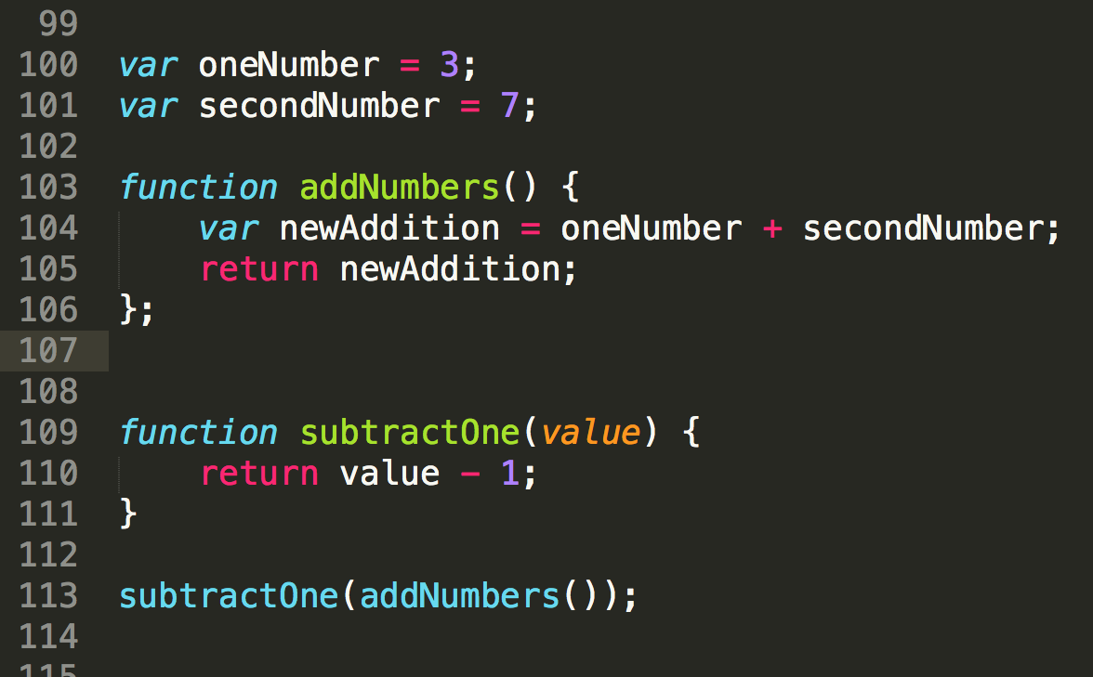
FUNCTIONS
Notes:
Can pass functions to other functions – THIS IS WHEN IT GETS FUN
Still follows traditional math setup – evaluates what is inside first – and then works outward
WHY DO YOU THINK WE DO THIS? Allows us to not have to re-write code if something needs to be changed
Makes our code much cleaner to read
TO BE CLEAR – the ‘return’ statement doesn’t function exactly like console.log
- console.log shows the information passed into it onto the console
- return passes back the value of the function
- console.log is for debugging and ’return’ is for programming

Slide 62
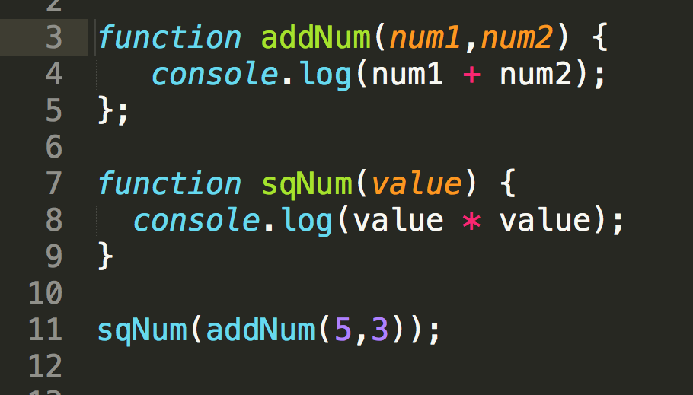
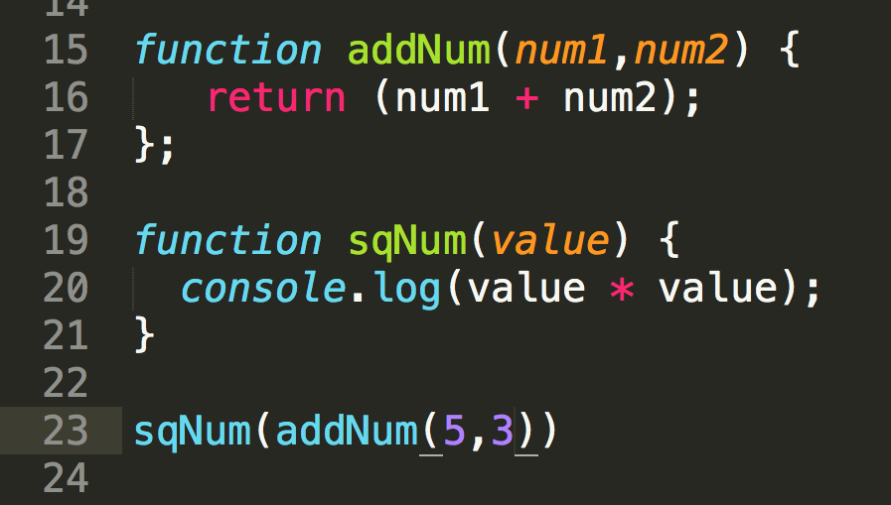
FUNCTIONS – keyword ‘return
Notes:
RETURN VS CONSOLE.LOG
Console.log – logs information to the console – does not pass the value back to the function call
Return – passes the information back to the function call which you can then reuse in other functions or assign to variable

Slide 63
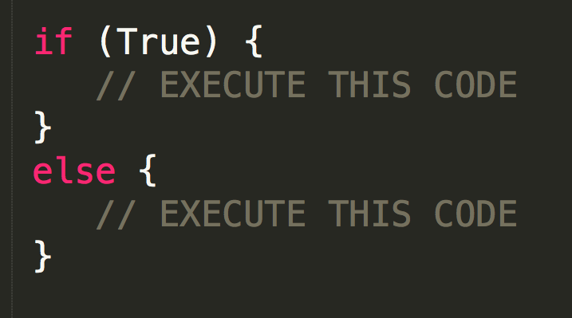
IF…ELSE IF….ELSE Statements
Conditional Statements: they determine if a statement is ‘true’ or ‘false’
Used to perform different actions based on different conditions

Slide 64
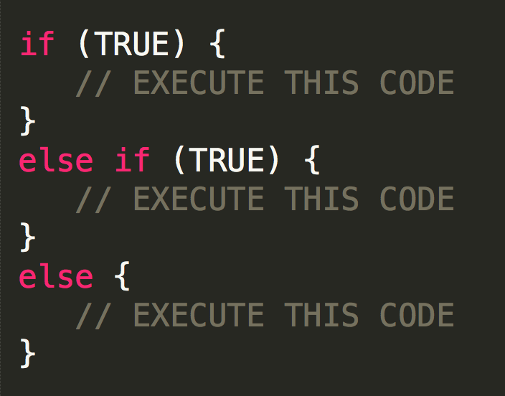
IF…ELSE IF…ELSE Statements
SYNTAX:
MUST begin with an if statement
Can have infinite ‘else if’ statements
MUST end with ‘else’
Browser will throw an error
Can make your conditionals
Truthy
(2 < 3)
Falsy
!(2 < 3)
Mostly see this for validation
!(’does this ’div’ have ’x’ class)
if it doesn’t, it will return true and you can add the class
if it does, it will return false and move to next statement

Slide 65
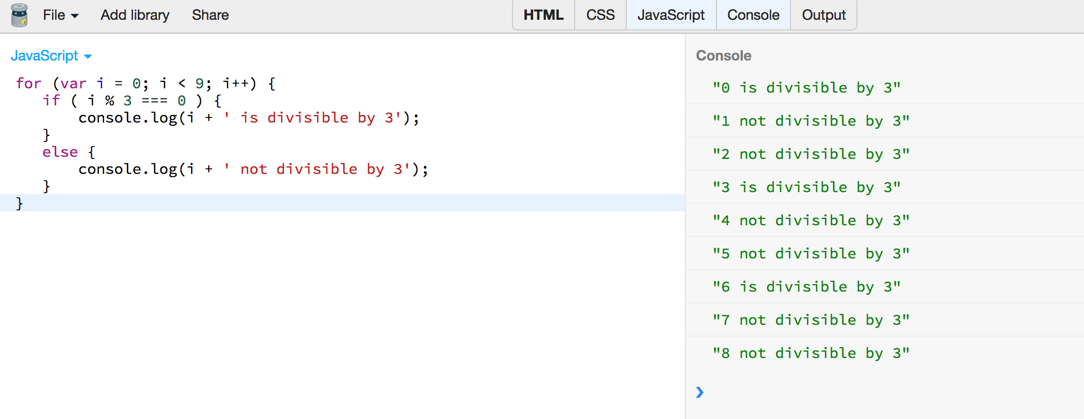

Slide 66
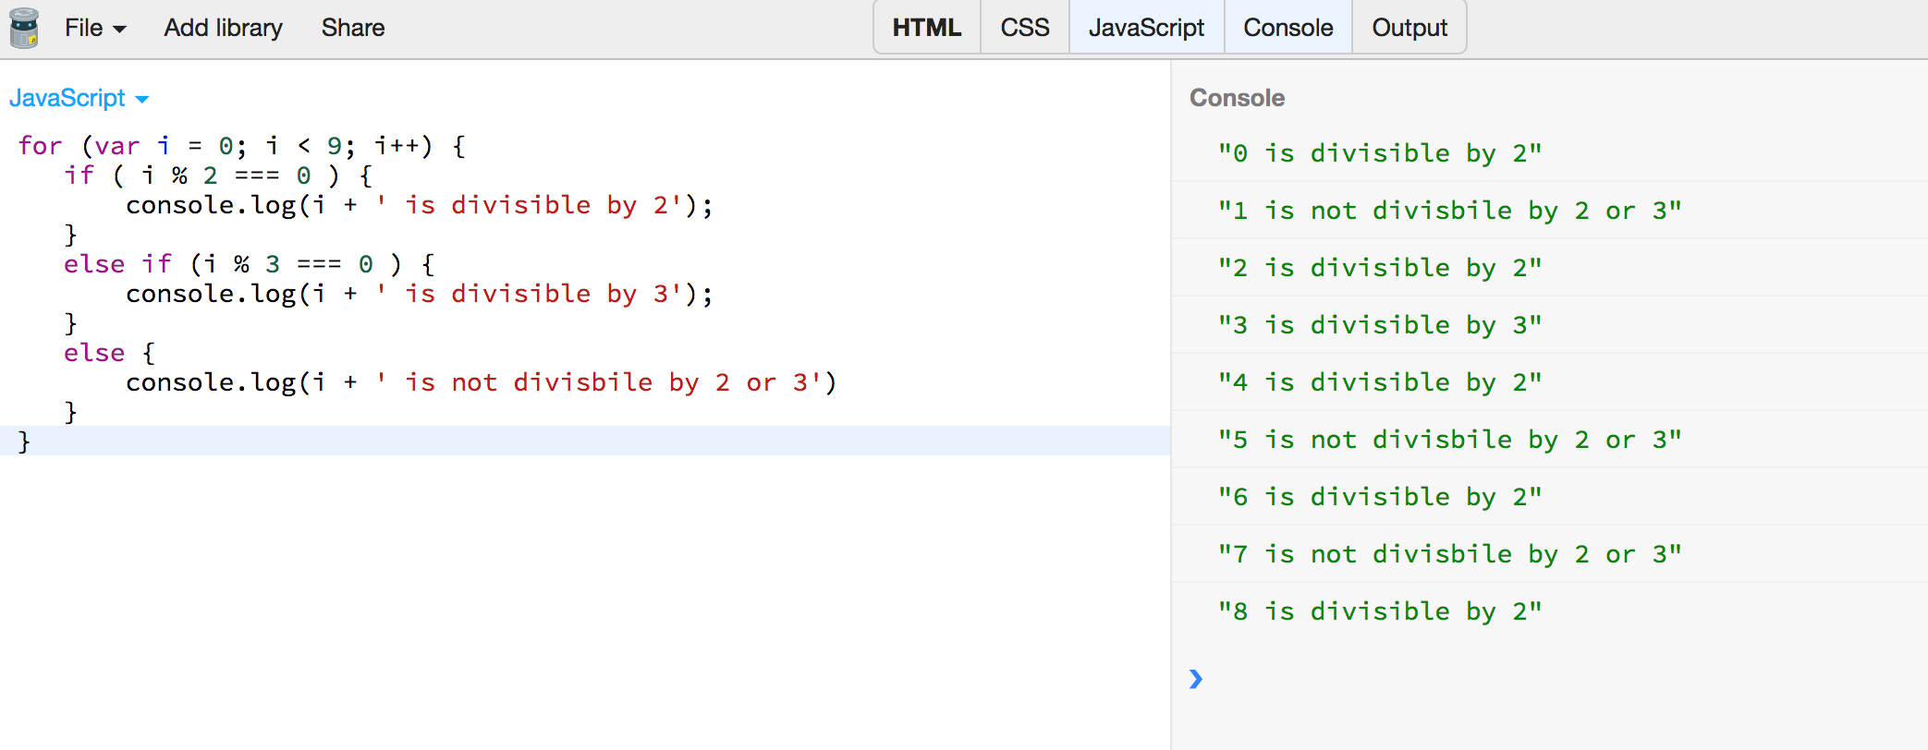

Slide 67
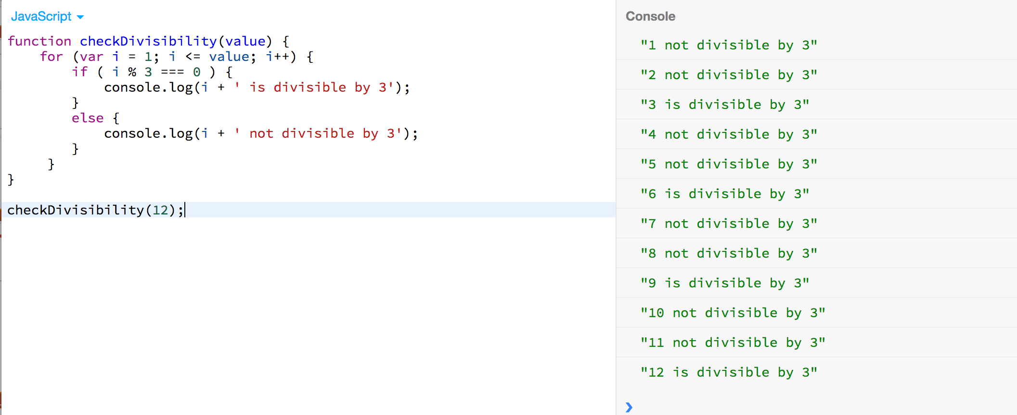

Slide 68
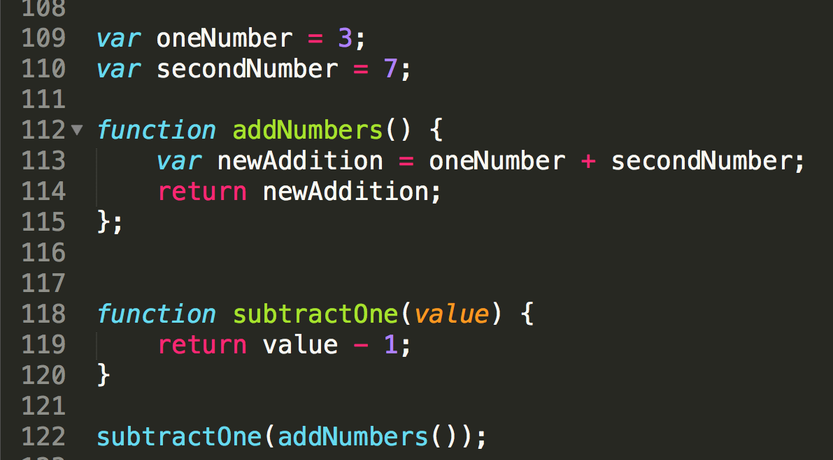
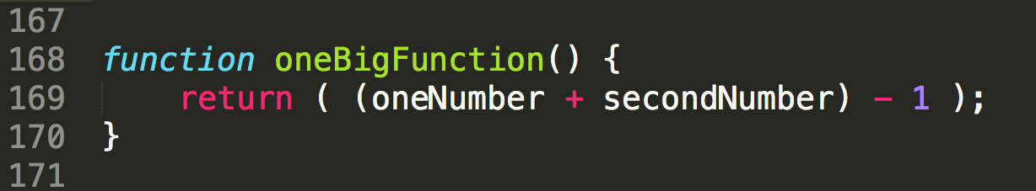
FUNCTIONS - Readability
Break down complex tasks
Readability
Lessens margin of human error
Allows for code flexibility
Allows for code reuse
Notes:
Less code doesn’t always mean better code and doesn’t make you a better developer – think about teammates and future developers
Can you reuse the second one? But couldn’t you reuse the subtractOne function somewhere else?
If someone wanted you to subtract 1 and then multiply it by 3 – imagine how the second function will look vs. updating the first

Slide 69
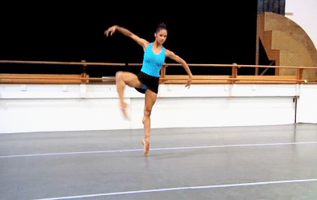
CODING OBSERVATION
Coding is FLEXIBLE!
Different code by different people can have same result!!
Not all code has to, or will, look alike!

Slide 70

FUNCTION PRACTICE! (with me)
1. Write a function that console.log’s your name. (Remember to pass in a string!)
2. Write a function that will square any number passed into it.
3. Write a function that will take a value and add it to an array that is outside the function.
Notes:
Use the array moment to re-introduce the synchronous nature of JS
var emptyArray = [];
function addValue(value) { emptyArray.push(value);}
addValue(3);
addValue(7);
addValue(15);
console.log(emptyArray); → [3,7,15] – JS went in order rather than random

Slide 71
CODE-ALONG!
Notes:
Credit: https://giphy.com/gifs/gh-C6UVM5TbW1Y2s

Slide 72
FUNCTION PRACTICE!
1. Write a function that will return the name of an animal you pass in.
2. Write a function that will divide the number you pass in by 5.
3. Write a function that will console.log the values of any object. Use object captainPlanet to check your fxn.
4. Write a function that will add 1 to every element of an array that is passed in. Use addMeUp to check your fxn.
5. Write a function that will tell me the dataType of every element in an array that is passed in. Use mixedUpTypes to check your fxn.

Slide 73

Remember – YOU CAN DO THIS!
Notes:
Credit: https://giphy.com/gifs/beyonce-hair-flip-11wsZr0jbXc15m

Slide 74
FUNCTION PRACTICE!
1. Write a function that will return the name of an animal you pass in.
2. Write a function that will divide the number you pass in by 5.
3. Write a function that will console.log the values of any object. Use object captainPlanet to check your fxn.
4. Write a function that will add 1 to every element of an array that is passed in. Use addMeUp to check your fxn.
5. Write a function that will tell me the dataType of every element in an array that is passed in. Use mixedUpTypes to check your fxn.
Notes:
WRITE THE ARRAYS AND OBJECTS FOR THESE EXERCISES

Slide 75

OMG POP QUIZ!
1. What’s the difference between a float and integer?
2. True/False: You can only get the value from an object using dot.notation. e.g. object.key = value
3. What are 2 major differences between arrays and objects?
4. What’s another name for JavaScript?
5. True/False: JSON is a group of arrays.
6. True/False: Functions must always take a parameter.
7. True/False: Less code is always better code.
Notes:
Credit: https://giphy.com/gifs/surprise-fabulous-pajamas-A5F11Cbo7b8cw

Slide 76
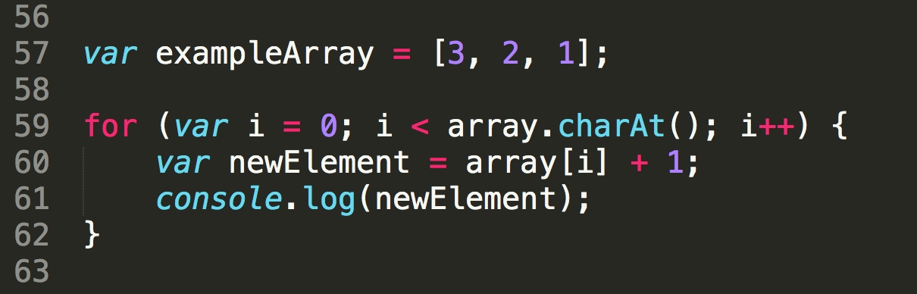
WHAT’S WRONG?
Notes:
Wrong array name
Array.length

Slide 77
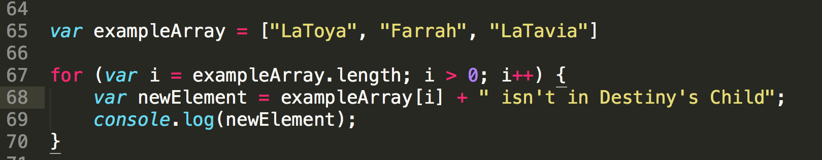
WHAT’S WRONG?
Notes:
How we instantiate the variable i

Slide 78
HTML REVIEW
HTML is Hypertext Markup Language
Consists of group of ‘elements’ (everything between start and end tag)
Can have ’nested’ HTML elements (divs within divs, lists, etc.)

Slide 79
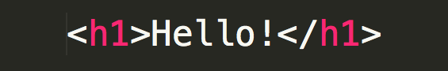
HTML REVIEW
HTML Syntax:
Open tag
Content
Close tag (the open tag with a “/”)
Open tag
Closing tag
Content

Slide 80
HTML REVIEW
Header Tags
<h1></h1>, <h2></h2>, etc.
As numbers increase, size of font decreases
Paragraph Tag
<p>This is what a paragraph element looks like.</p>
Image Tag
<img src=“/images/cloud.png alt=“Cloud image” />
Link Tag
<a href=“www.google.com”></a>

Slide 81
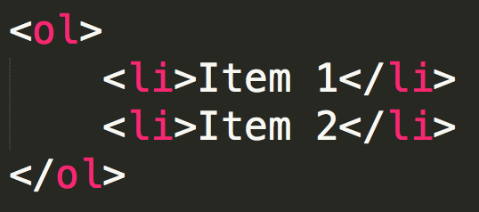
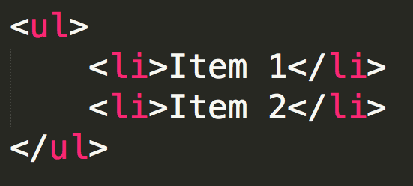
HTML REVIEW
List Tag (Ordered and Unordered)

Slide 82
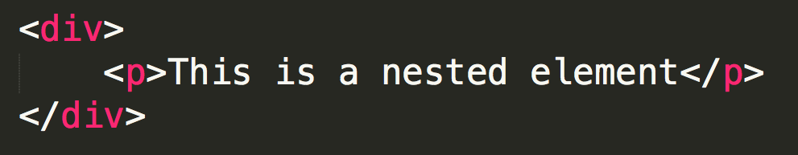
HTML REVIEW
Div Tag (Division)
Block element
Used for code ’blocks’
Breaks up the HTML page
Span Tag
Inline element
Surrounds small portions of text, images
Notes:
http://stackoverflow.com/questions/183532/what-is-the-difference-between-html-tags-div-and-span

Slide 83
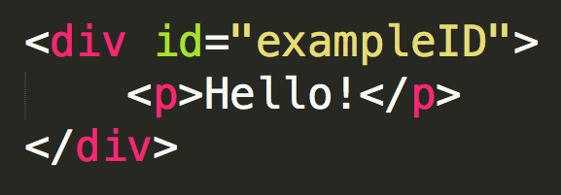
HTML REVIEW
Attributes – Gives more information to the browser – connected to CSS
ID, Class, Alt (Alternative Text, Accessibility), In-line CSS, Href

Slide 84
CSS REVIEW
CSS = Cascading Stylesheets
Cascading: styles can be overwritten and overruled
Stylesheets: document(s) that tell the browser how to render the page
Style rules are followed top to bottom
In the sheet
In your HTML document
Consists of selector, property, and value

Slide 85
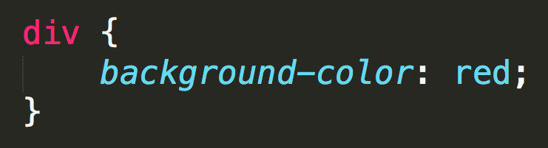
CSS REVIEW
CSS Syntax
Selector: div element or HTML attribute
IDs begin with “#”, Classes begin with “.”
Selector
Value
Property

Slide 86
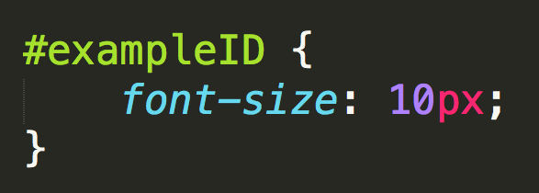
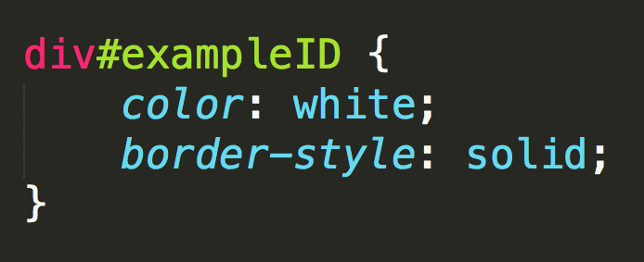
CSS REVIEW

Slide 87
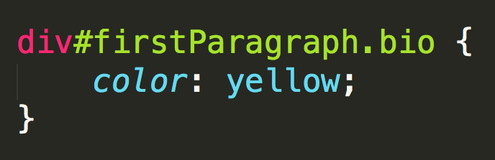

CSS Selectors
Multiple selectors
Use of Commas

Slide 88


CSS REVIEW
Descendants
Direct Child
Notes:
http://learn.shayhowe.com/advanced-html-css/complex-selectors/

Slide 89


How will it render?

Slide 90


Slide 91

How will it render?

Slide 92


Slide 93
CSS
Pseduo-classes:
Keyword added to selectors that specify a special state of the element to be selected (Mozilla Foundation)
Let you apply a style to an element:
In relationship to the document tree (traditional selectors)
History of the navigator (:visited)
Status of the content (:checked)
Position of the mouse (:hover)
Notes:
https://developer.mozilla.org/en-US/docs/Web/CSS/Pseudo-classes

Slide 94
CSS – Pseudo-Selectors
Syntax:
Just like traditional CSS
Include the pseudo-selector after the selector (including class and ID)
Examples:

Slide 95
DOM Manipulation
DOM – Document Object Model
Platform and and interface that allows programs and scripts to dynamically access and update the context structure and style of a document (W3C standard)
Created by browser when page is loaded
Created using HTML and CSS files
DOM tree is created (creates elements, text nodes, attribute nodes, etc.)
Because it is a model it can be used by JS to create dynamic HTML:
Change elements on a page
Change attributes on a page
Change CSS styles on a page
React to events on a page
And others
Is represented by the ’document’ object in JavaScript

Slide 96


Notes:
Credit: https://www.w3schools.com/js/pic_htmltree.gif

Slide 97
DOM Manipulation
Can manipulate 3 ways:
1. Inline JavaScript
2. Script tag in HTML document
3. JavaScript files

Slide 98
DOM Manipulation
1. Access the element (using methods)
document.getElementByID()
document.getElementByClassName()
document.querySelector() → Returns first match
document.querySelectorAll() → Returns all matches
Notes:
Look at DOM_Manip
Make sure to point out all the attributes on ’bio’ element

Slide 99
DOM Manipulation - Lists
Some methods will return arrays:
getElementsByClassName()
querySelectorAll()
To access individual elements:
Item(index-of-list-item)
memberElements.item(1)
Array synatax
memberElements[1]

Slide 100
DOM Manipulation - Loops
Since methods return arrays – we do looping
Notes:
Go to

Slide 101
DOM Manipulation – Text Content
To get text from the DOM:
1. innerHTML → returns text and the HTML content
2. textContent → returns text, does not ’obey’ CSS
3. innerText→ returns text, does ’obey’ CSS
If CSS has text ‘hidden’ it will not return it

Slide 102
PRACTICE WITH DOM MANIP
Open DOM_Manip_Practice
Use JavaScript to do the following tasks:
1. Print Solange’s name to the console
2. Print Solange’s 3rd album to the console – just text
3. Print Solange’s 2nd album to the console – with markup
4. Print all of Solange’s albums to the console

Slide 103
DOM Manipulation – Change Text
Using the same methods you used to grab text – you can change it!
Remember these are attributes on an object, how do you think you can change it??
Notes:
STATIC VS LIVE NODELIST
When you coerce the browser into using innerHTML or other methods it moves from being a live list to a static list

Slide 104


DOM Manipulation – CSS Classes
To manipulate CSS classes uses the ‘classList’ property
Syntax:
[selector].classList.[method]
Methods:
add(’className’, ‘className’)
remove(‘className’)
contains(‘className’)
Returns true if present
Returns false if not
Notes:
https://developer.mozilla.org/en-US/docs/Web/API/Element/classList
May not work on versions of Firefox

Slide 105

DOM Manipulation – DOM elements
Create a DOM element:
1. Create the element
var newEl = document.createElement(‘li’);
2. Create a text node (if needed)
var newText = document.createTextNode(‘New Member’);
3. Append the text node to the element
newEl.appendChild(newText)
4. Find (cache) the position of desired element
var position = document.getElementByTagName(‘ul’)[0]
5. Append new element to the position
position.appendChild(newEl);

Slide 106
Notes:
Credit: https://www.w3schools.com/js/pic_htmltree.gif

Slide 107

DOM Manipulation – DOM elements
Remove a DOM element:
1. Find the element you want to remove
var removeEl = document.getElementsByClassName(‘newMember’)[0];
2. Find the parent of the element
var parentEl = removeEl.parentNode;
3. Use removeChild() method to remove the child
parentEl.removeChild(removeEl);
Shorter Syntax: removeEl.parentNode.removeChild(removeEl);
Doesn’t require you create a variable for the parent node

Slide 108
DOM Manipulation
2. Work with the element
- Select element from nodeList (getElement + item() ) p198
- Loop through nodelist – p. 205
- Get text content – innerHTMl, textContent (213)
- Changing text node – 215
- Change class – p. 218 - 234
- Add element to DOM – p. 222
- Remove element from DOM p.224

Slide 109
PRACTICE WITH DOM MANIP
1. Change header of the page from ‘African-American Writers’ to ‘African-American Authors’
2. Add a class to the <ul> element that adds a border to the list
3. Add a list item to the unordered list with the text: Alice Walker
4. Add a class to your Alice Walker list item that will change the text color to any color other than black

Slide 110
POP QUIZ ON MATERIAL
1. How do you write a loop for arrays?
2. How do you write a loop for objects?
3. What is the difference between a function declaration and a function expression?
4. What is a conditional statement?
5. What does the ‘return’ keyword do?
6. Using JavaScript, what is the object we use to manipulate the DOM?
7. Do all nodes have attributes? Do all nodes have text nodes?

Slide 111

BREAK!

Slide 112
EVENTS
Users tend to interact with websites using ‘events’
Events include actions such as: (List found here)
Clicking
Key-up, Key-down
Doubleclicking
Submitting a form
Selecting a checkbox
The browser listens for events
We are able to make changes to our website based on these events
Events are fired/raised → Events trigger scripts

Slide 113
EVENT HANDLING
Steps that are used to get HTML to trigger scripts
1. Select the element
2. Specify which event
3. Call the code
3 Ways to Bind Events to HTML elements
HTML Event Handlers (bad practice)
DOM Event Handlers
Event Listeners
Notes:
HTML Event Handlers
- bad practice because you want to separate your JS from your HTML

Slide 114

HTML EVENT HANDLERS
List of HTML Event Attributes (here)
Steps that are used to get HTML to trigger scripts
1. Select the element
2. Specify which event
3. Call the code

Slide 115

EVENT HANDLING - DOM Event
Steps that are used to get HTML to trigger scripts
1. Select the element
2. Specify which event
3. Call the code
Syntax:
ELEMENT.onEVENT = functionName; (found in JS file)

Slide 116

EVENT HANDLING – Event Listeners
Steps that are used to get HTML to trigger scripts
1. Select the element
2. Specify which event
3. Call the code
Syntax:
element.addEventListener(‘event’, ’functionName’) (found in JS file)
Notes:
// if you want to pass in a parameter you need to send in a function to the event function (p.256)
addEventListener(’mousemove’, function() {
showAnswer(5);
});
’functionName’ is CALLBACK FUNCTION

Slide 117
EVENT OBJECT
Every time an event is called – an ‘event’ object is made (shorthand: ‘e’)
Must pass in the ‘e’ object to function to get access to it
Important properties of object
e.target (target of the event)
e.type (type of event)
Important methods
e.preventDefault() – cancels default behavior
e.stopPropagation() – stops events from bubbling or capturing
Notes:
Common Default Behaviors:
clicking on link and going to href
Submission on link

Slide 118


Slide 119
EVENT DELEGATION
What happens if we have a long list of items?
Use parent element to listen to all of its children → event delegation
Looking back at our ’event’ object
event.target gives you a variety of properties that you can use
Syntax:
parentElement.addEventListener(‘event’, function(e) {
// RUN CODE HERE
// Access to ‘clicked’ li is found at e.target
}

Slide 120



Slide 121

QUESTIONS?

Slide 122
YOUR TURN!!
Open Event_Practice#2
1. Use HTML Handler to change title to ‘First Ladies of Jazz’
2. Use an Event Handler (DOM or Event Listener) to show the list of Jazz Singers
3. Use Event Delegation so when a person’s name is clicked – a fact shows up about them!

Slide 123
QUIZ
1. What is an integer? What is a float?
2. What is the difference between an array and an object?
3. What does () do after a function name?
4. What do we call the data we put in-between () when we write and call a function?
5. What is a benefit of using Event Listeners?
6. What is ‘e’ in Event Listeners and DOM Event Handlers?

Slide 124
ANYTHING YOU CAN DO WITH jQUERY YOU CAN DO WITH VANILLA JAVASCRIPT!!

Slide 125
jQuery
JavaScript library designed to help simplify client-side scripting of HTML
Free and open-source
Most widely-used JS library
Makes it easier to:
Navigate a document
Select DOM elements
Handle events
Create animations
Develop Ajax applications
Must include script tag above your JS file to use jQuery
Notes:
https://en.wikipedia.org/wiki/JQuery

Slide 126
jQuery - Syntax
Basic Syntax:
$(‘selector’).method()
Must use “$”
Must use ‘ ‘ with the selector
DOM element selectors are just like CSS selectors
jQuery comes with helpful methods such as: (List)
.addClass()
.hide()
click()
.removeClass()
Notes:
By using the $ you get access to the jQuery methods – it wraps that object in a jQuery object

Slide 127
jQuery – DOM Manipulation
To get all “li” on a page
$(‘li’)
To get a ‘p’ with a class of ‘orange’
$(‘p.organge’)
To get elements with ’href’ attribute
$(‘attr=href’)
To get “div” with a “span” with a ’onclick’ attribute
$(’div:has(span[onclick])) ’

Slide 128
jQuery – DOM Manipulation
Add Class – addClass()
Remove Class – removeClass()
Add Element – after() or before()
Remove Element – remove()
Change CSS – css()

Slide 129
jQuery – Event Listeners
All event listeners require a callback function (A function within a function)
Click Event – click()
Hover - hover()
Mouseover - mouseover()

Slide 130
jQuery – Event Listeners
All event listeners require a callback function (A function within a function)
’on’ Method – allows you to set multiple events
Pass in an object
Object key/val pairs are ‘events’ (keys): ‘functions’ (value)
$(document).on({
click: function(),
mouseover: function()
})

Slide 131
Notes:
Credit: https://giphy.com/gifs/bfv-braxtons-towanda-traci-3o7TKJbg9tcu3OkF7a

Slide 132
NOW IT IS YOUR TURN TO HAVE FUNSIES!!!
Notes:
Go to directory ‘Your Turn’

Slide 133
RESOURCES
jQuery Events: https://api.jquery.com/category/events/
jQuery Mouseevents: https://api.jquery.com/category/events/mouse-events/
jQuery Fading: https://api.jquery.com/category/effects/fading/
jQuery CSS: https://api.jquery.com/category/css/
jQuery Animate: http://api.jquery.com/animate/
jQuery Attributes: http://api.jquery.com/category/attributes/

Slide 134

jQuery – AJAX Requests
$.get()
Uses a callback function!
Documentation: http://api.jquery.com/jQuery.get/
FORMULA IS:

Slide 135
jQuery - AJAX
4 Types
GET
Get information
PUT
Update or insert new information
POST
Add new information
DELETE
Delete information
Each API is set up differently with how to make ‘calls’
Look at documentation
It is okay to make mistakes hitting an API

Slide 136

Notes:
https://ptabdata.uspto.gov/ptab-api/swagger/index.html#!/documents/documents

Slide 137
Notes:
Credit: https://giphy.com/gifs/bfv-braxtons-towanda-traci-3o7TKJbg9tcu3OkF7a

Slide 138
Resources for Continued Learning
Code School (www.codeschool.io)
Eloquent JavaScript (http://eloquentjavascript.net/)
Pluralsight (https://www.pluralsight.com)
Udacity (https://www.udacity.com/)
jQuery Documentation (http://jquery.com/)
Javascript & jQuery – Book by Jon Duckett (http://javascriptbook.com/)

Slide 139

THANK YOU FOR COMING!
Hope you had as much fun as I did!!
Notes:
Credit: https://giphy.com/gifs/kim-kardashian-gif-simcity-buildit-QCevNzgfKTigg

